Slide 1
An introduction to
Arctic Science Partnership (ASP)
24. January 2018 – Arctic Frontiers, Tromsø, Norway

Slide 2
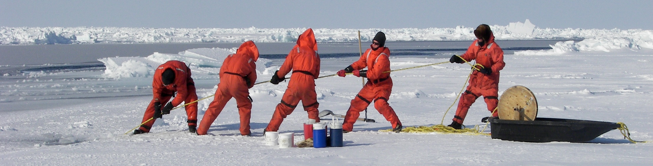
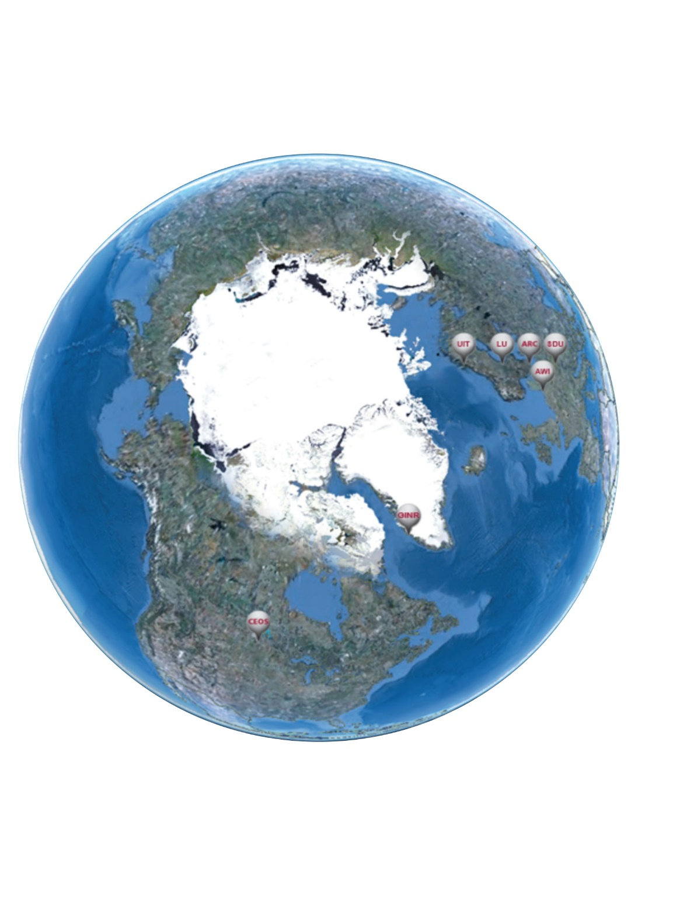
ASP is about collaboration
Research
Education
Operation
Administration
Communication
Student networks
www.asp-net.org

Slide 3
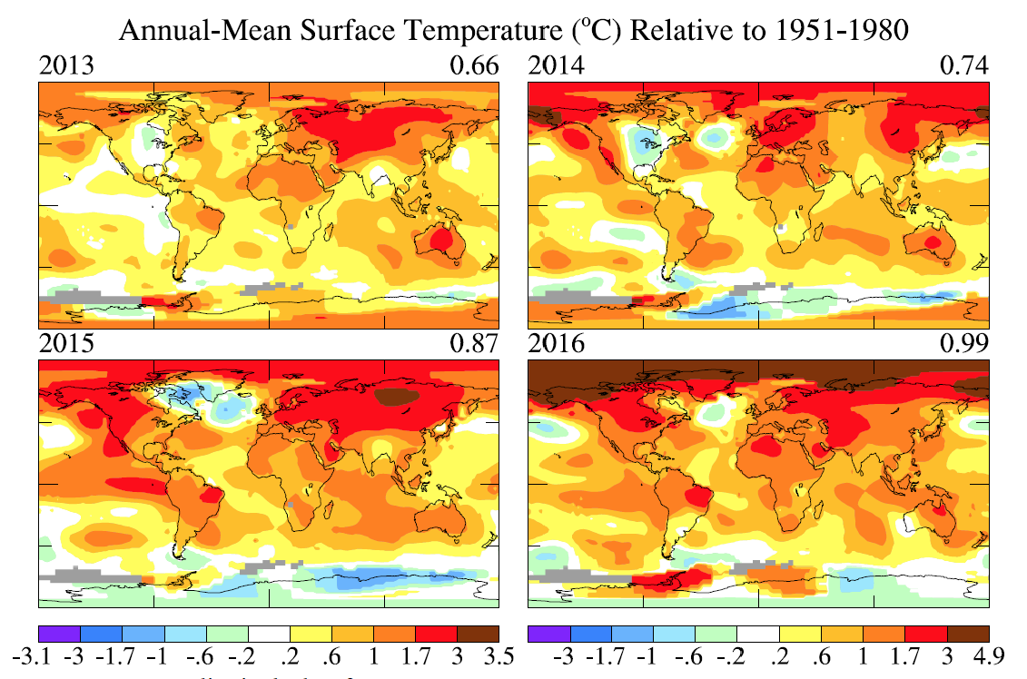
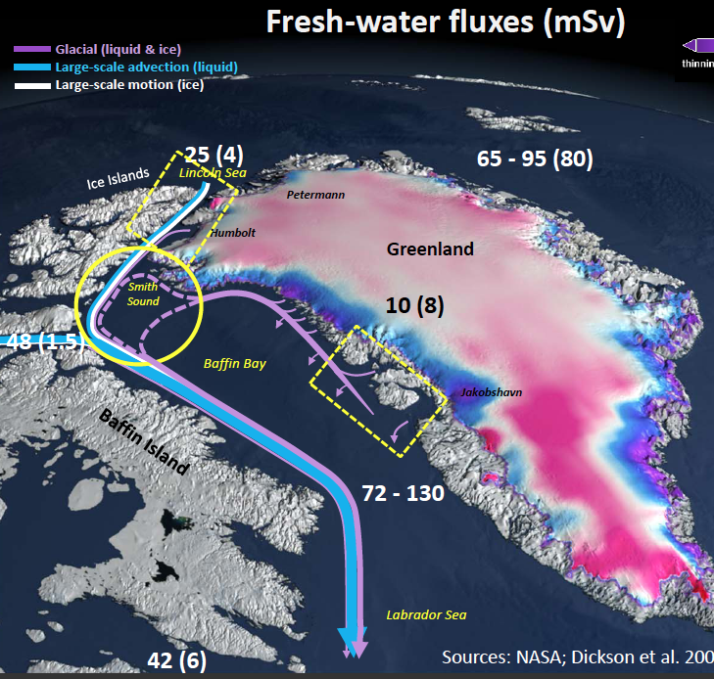
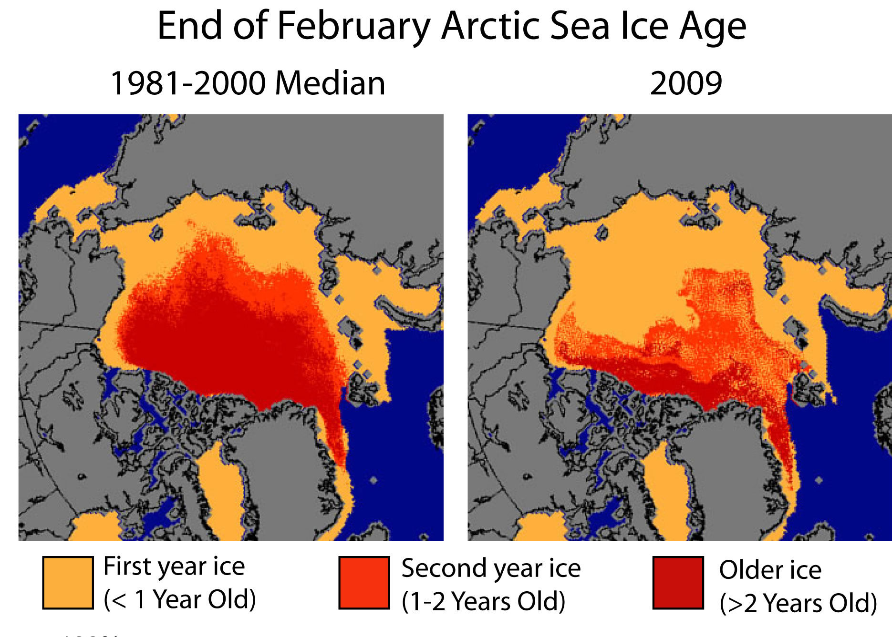
There is enough to collaborate on
Notes:
Give examples e.g. climate change understanding,
new shipping routes, safe travels, better weather forecast,
Fisheries advice, oil and gas exploitation, mining, geopolitical
Touristsm etc etc

Slide 4
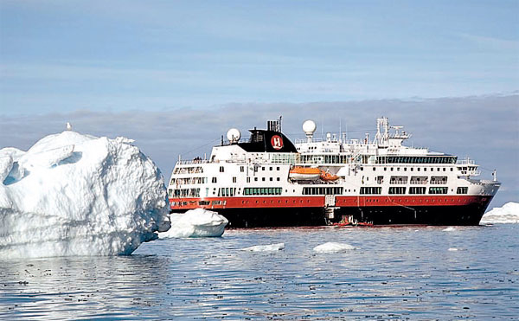
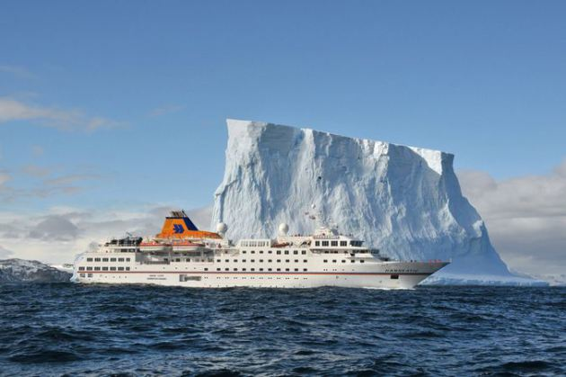
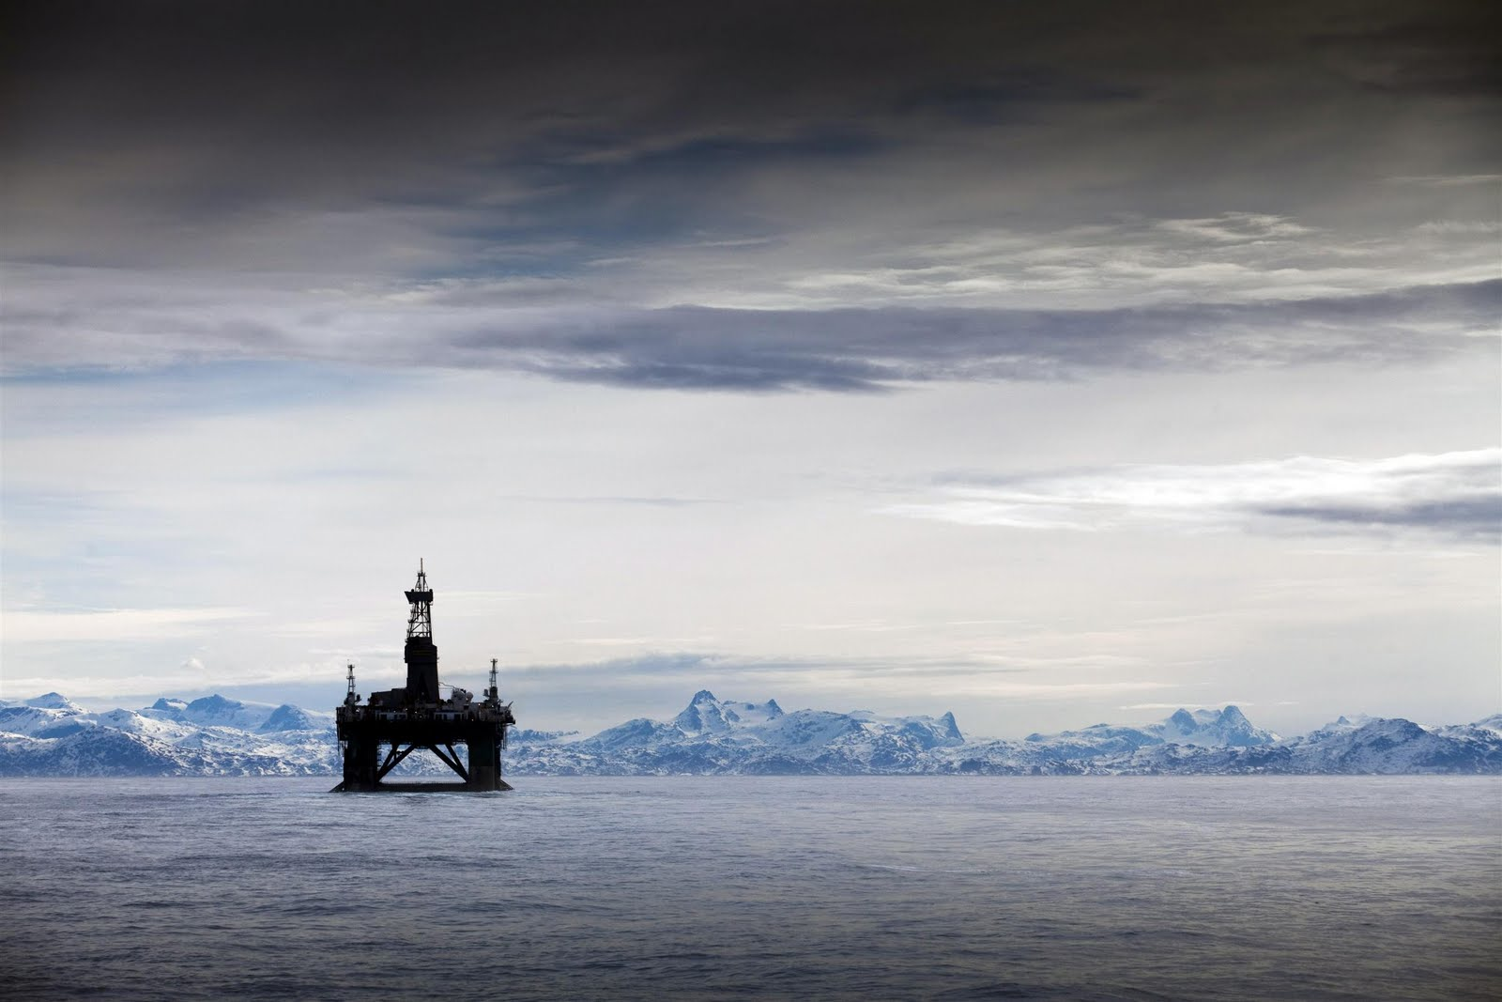
Tourism and new developments

Slide 5
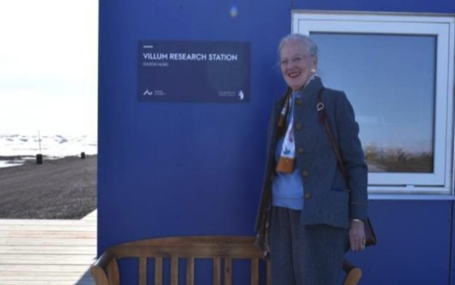
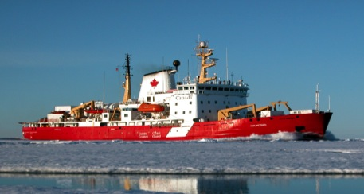
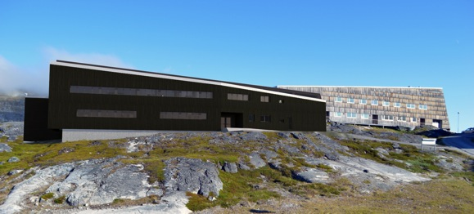
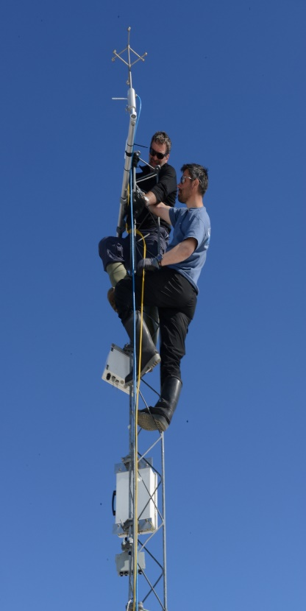
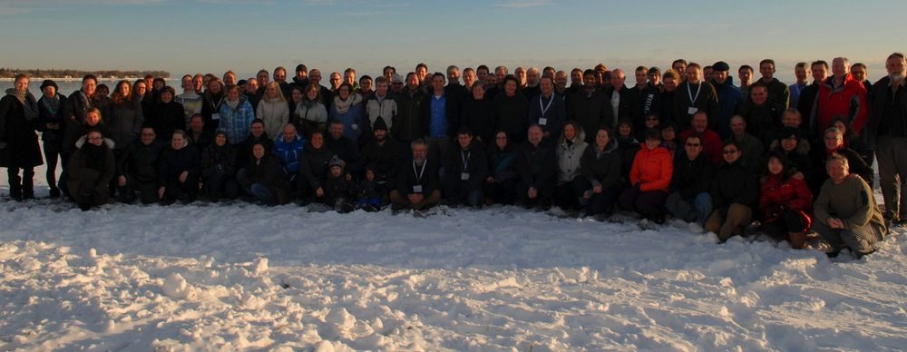
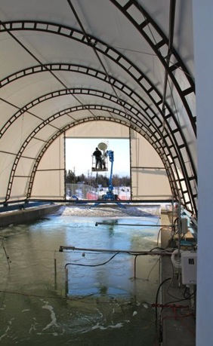
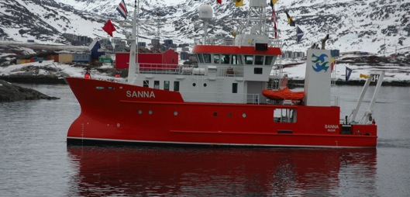
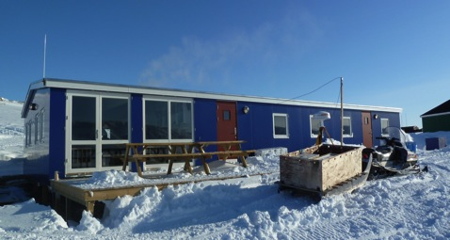
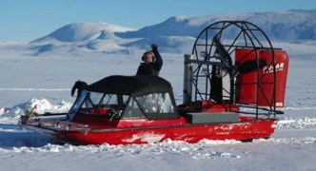
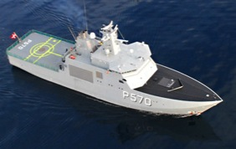
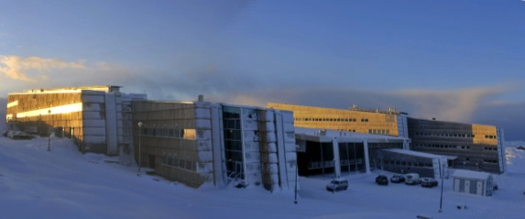
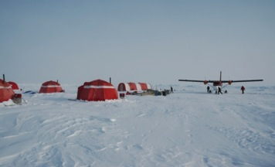
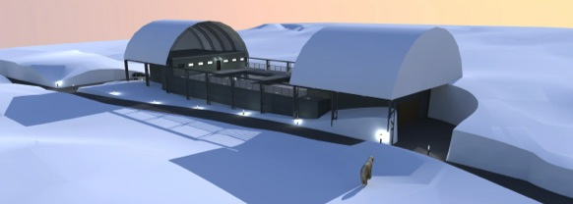
When we join forces – we can do great things!
Notes:
Put picture gimly

Slide 6

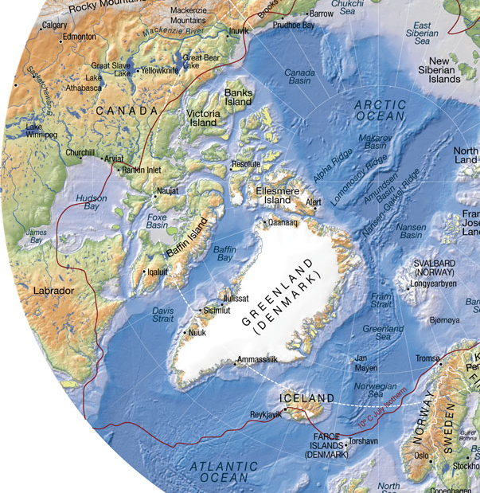
ASP Field Campaigns/projects 2012-17
2012: Young Sound
ASP Start-up campaign - March
2013:
Nuuk – 26 projects in Nuuk area
SERF – 3 projects
2014:
Young Sound – 14 projects
SERF – 3 projects
Nuuk – 1 project
Cambridge Bay – 14 projects
Amundsen – 5 projects
2015:
VRS Station Nord – 18 projects
Young Sound – 1 project
SERF – 3 projects
Amundsen – 7 projects
Green Edge – 2 projects
2016:
VRS Station Nord – 5 projects
Young Sound – 2 projects
SERF – 7 projects
Baffin Bay – 7 projects
Nuuk – 9 projects
Svalbard – 4 projects
Other projects – 7 projects
2017:
VRS Station Nord – 7 projects
Young Sound – 2 projects
SERF – 3 projects
Greenland Sea – 2 projects
Nuuk – 2 projects
Svalbard – 5 projects
Baffin Bay – 8 projects
Other projects – 3 projects
2013- 2017
2013- 2017
2013- 2017
2013- 2017
2016 2017
2015
2016 2017
2016 2017
2017
2013-2014
2016- 2017
2012
2014- 2017

Slide 7
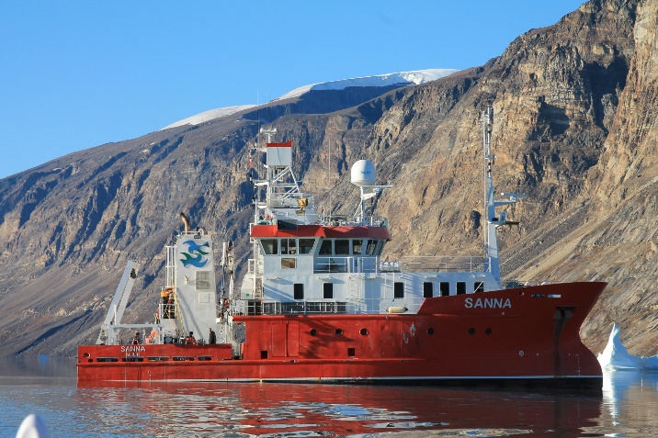
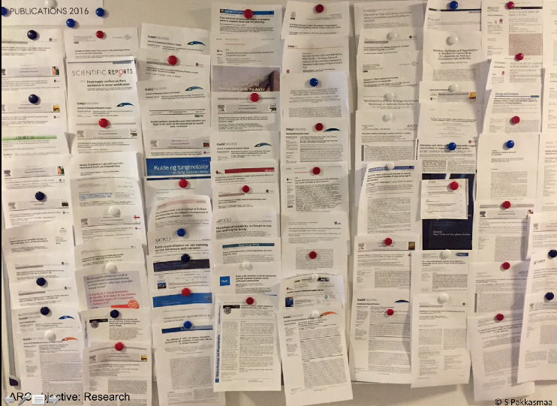
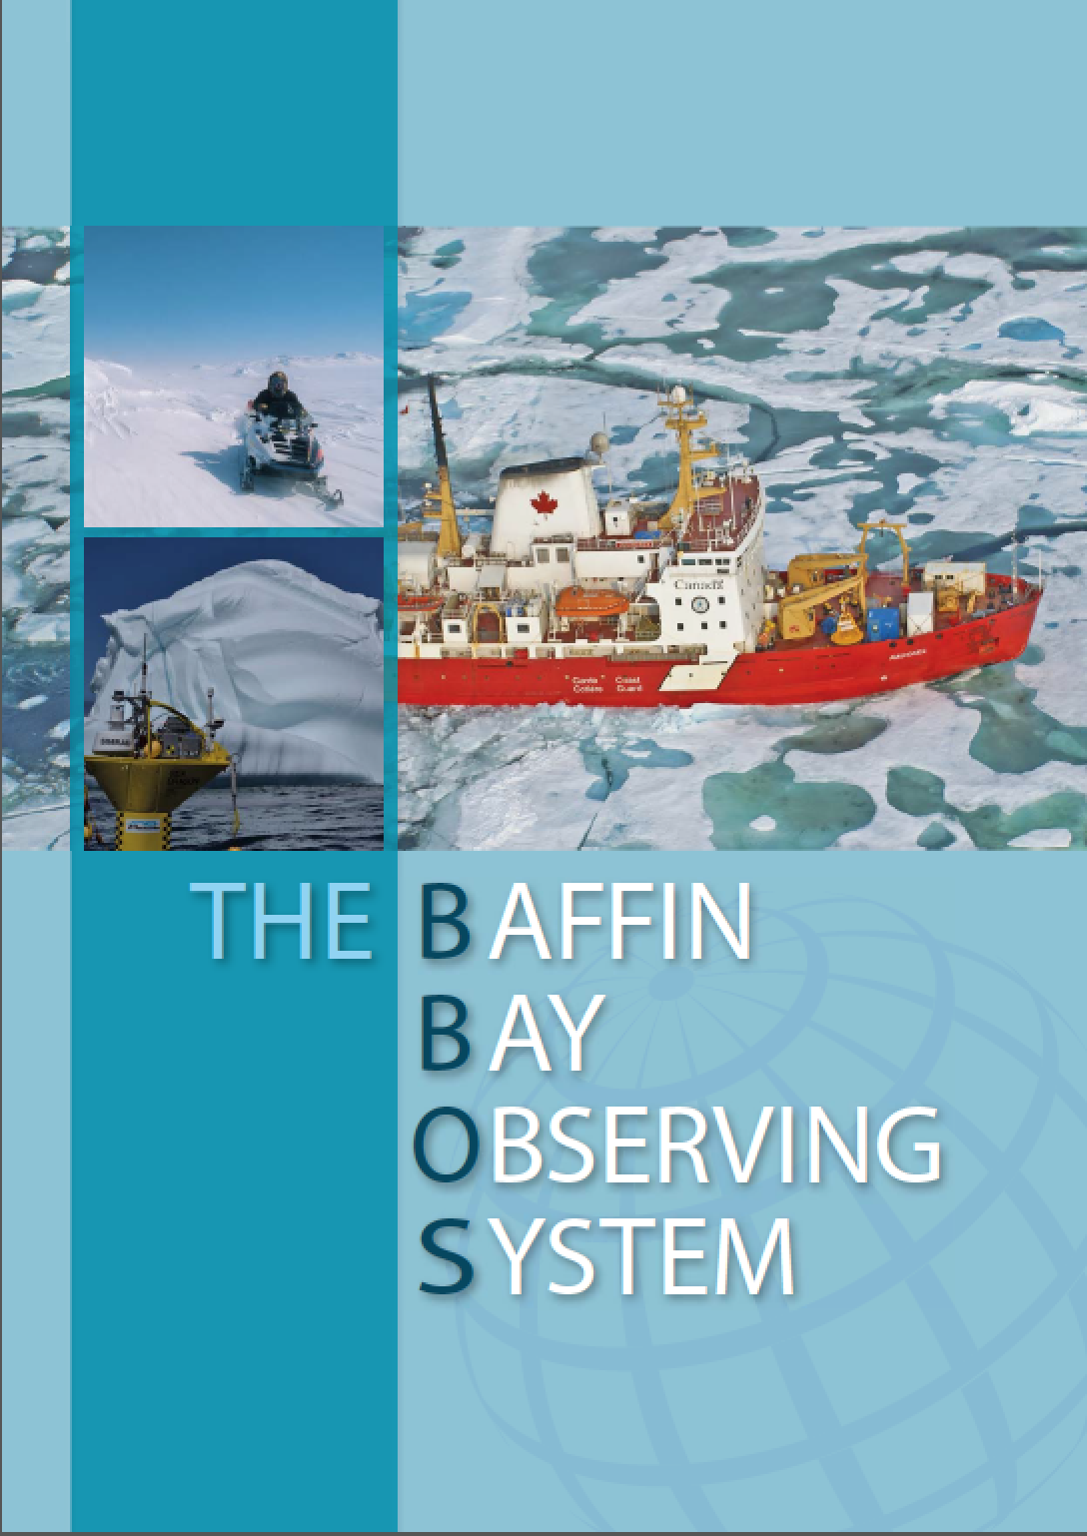
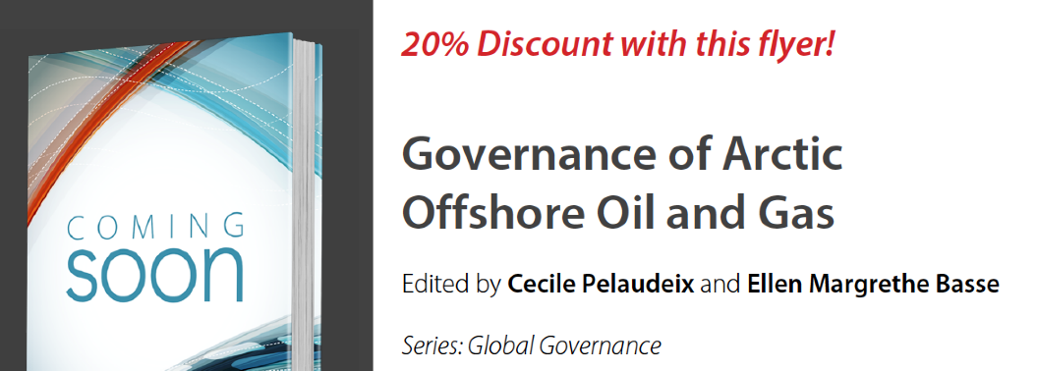
Achievements
Research
Lots of joint field campaigns
per year
Hundreds of publications per year
Lots of joint applications
each year

Slide 8
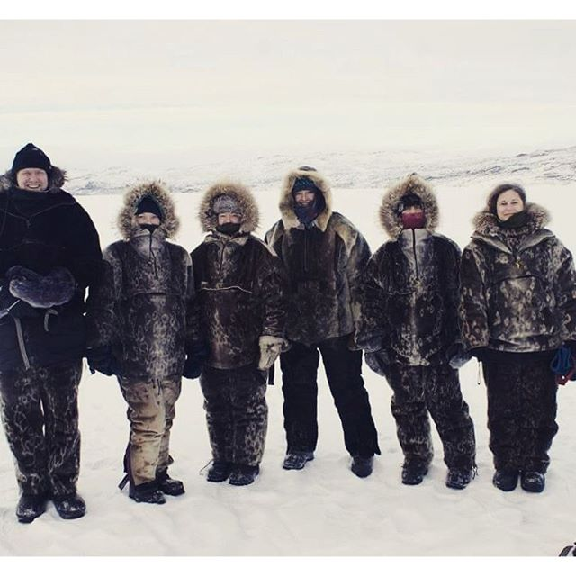
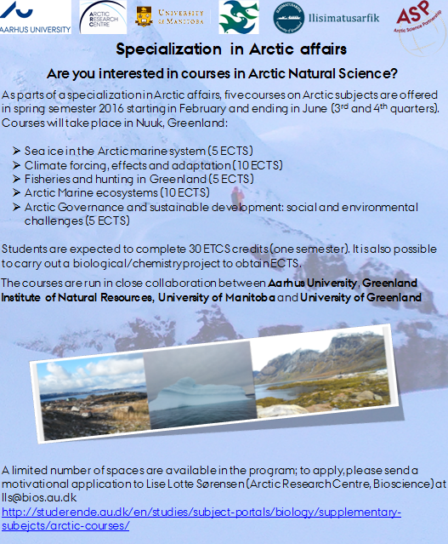
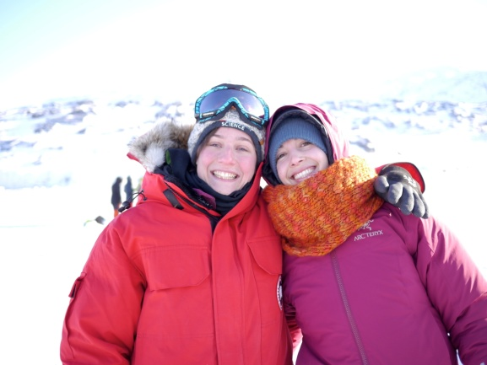
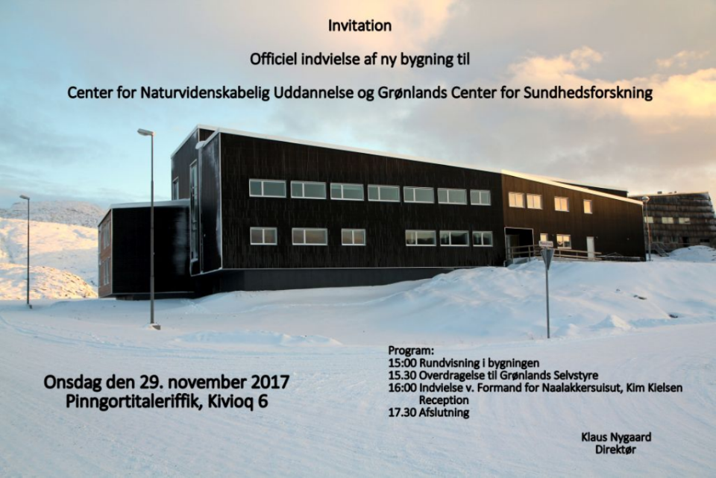
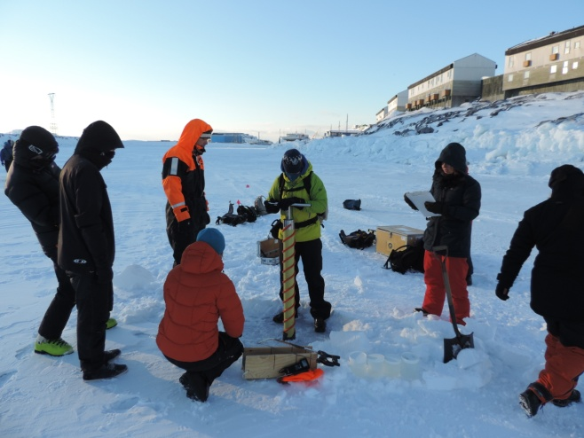
Achievements
Education and talent development

Slide 9
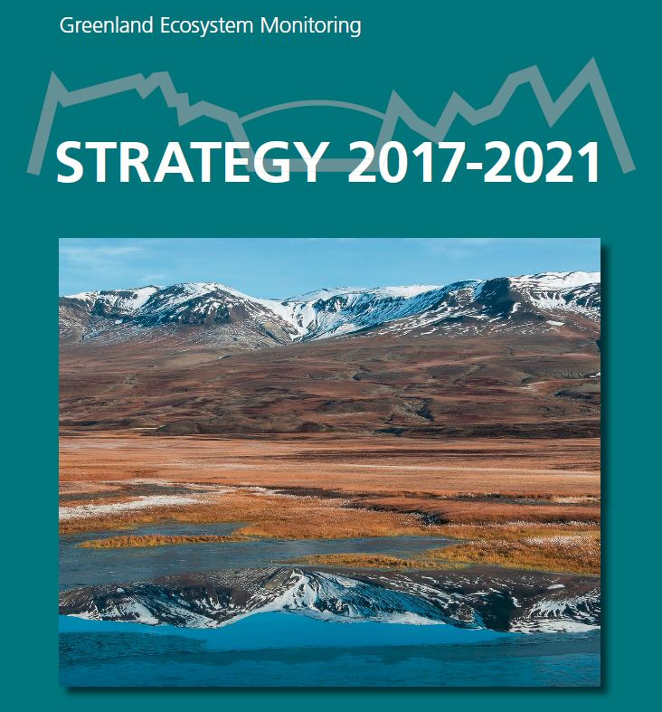
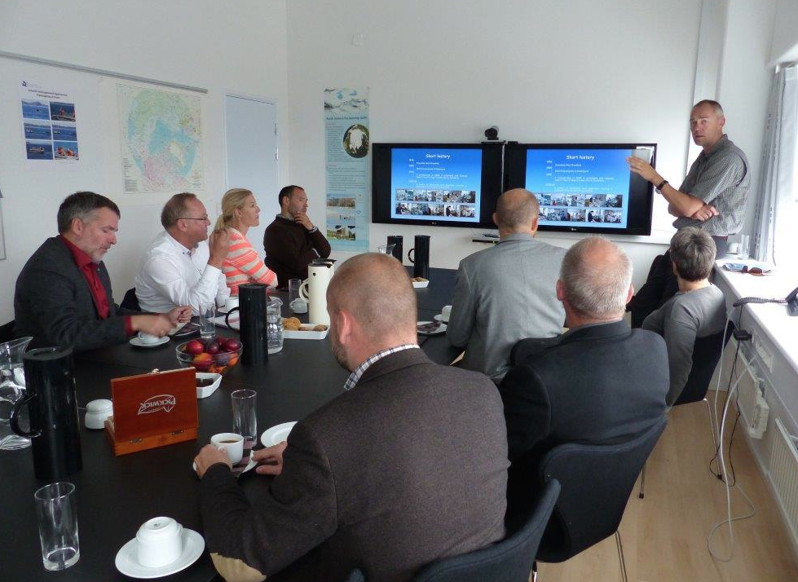
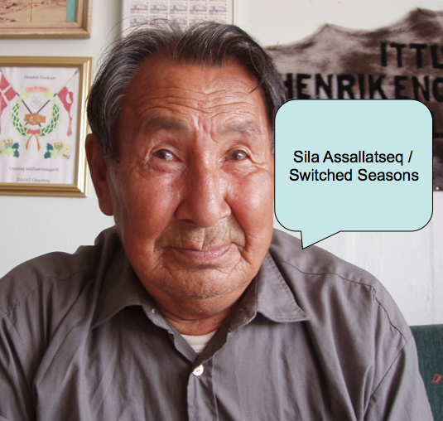
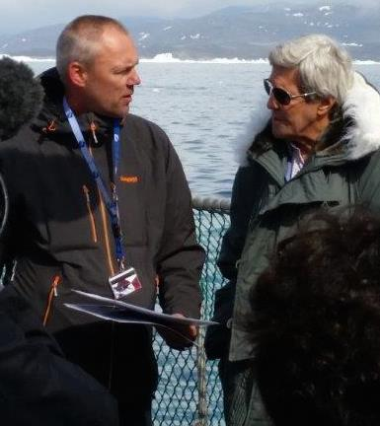
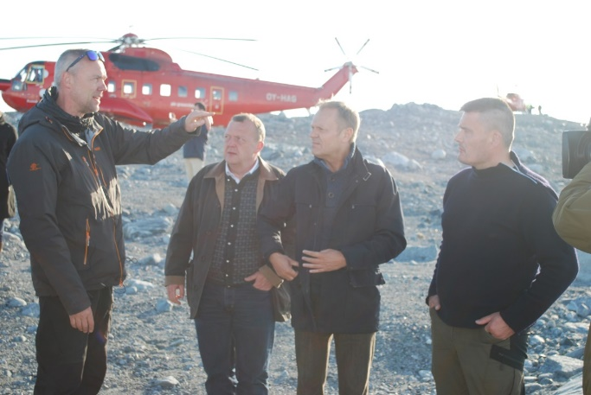
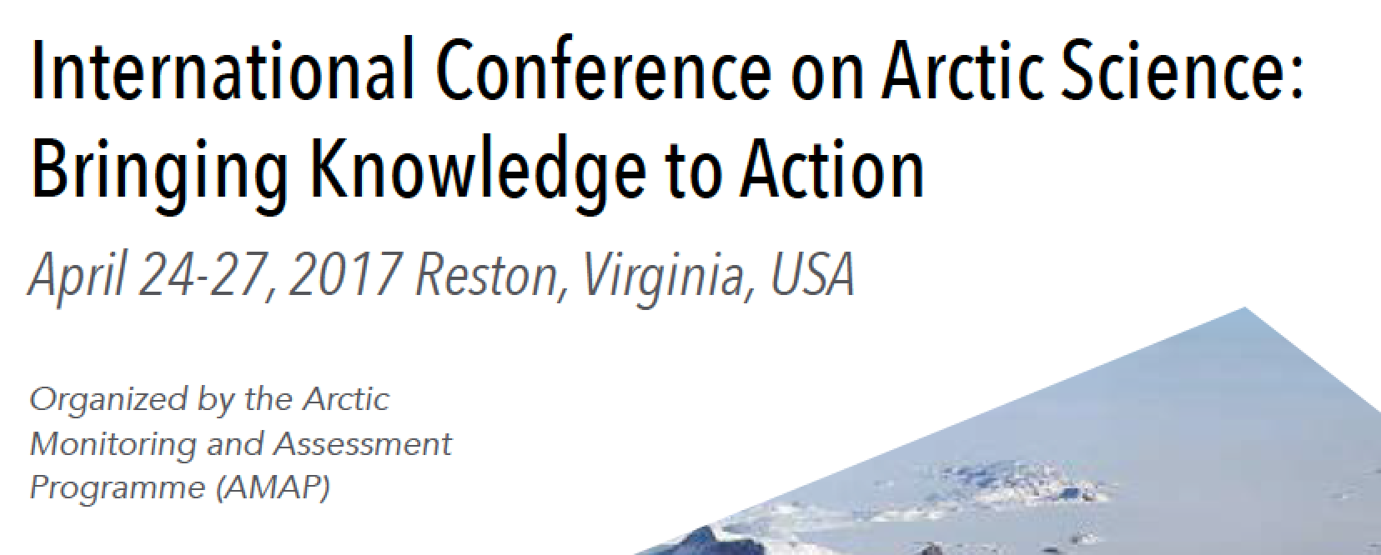
Achievements
Knowledge exchange

Slide 10
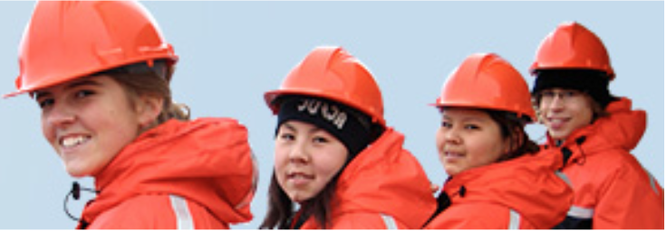
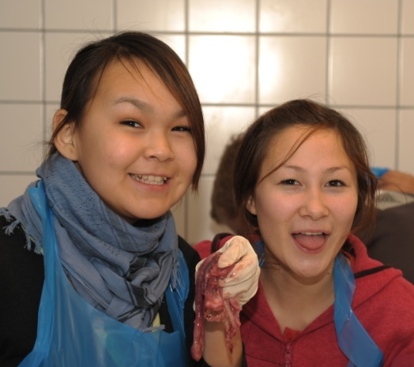
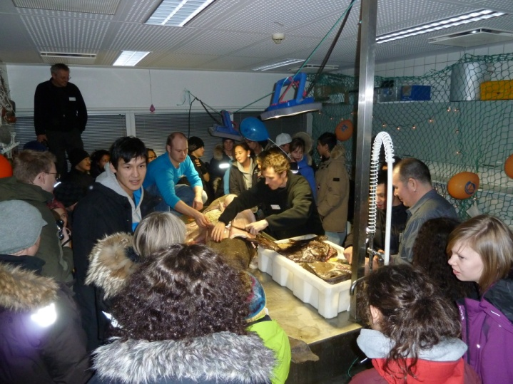
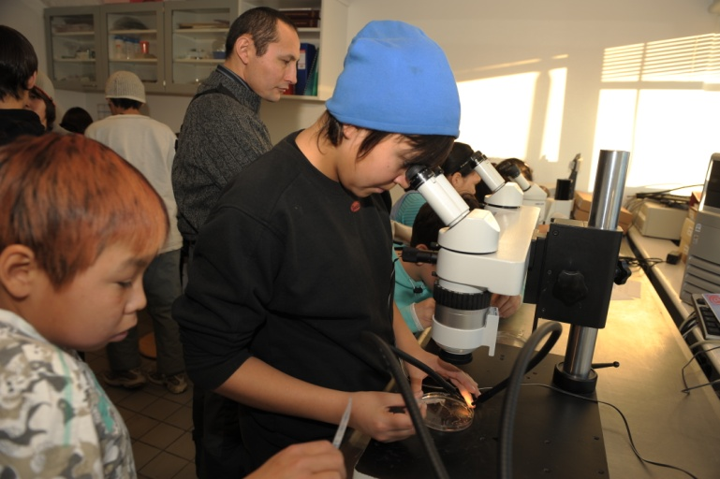
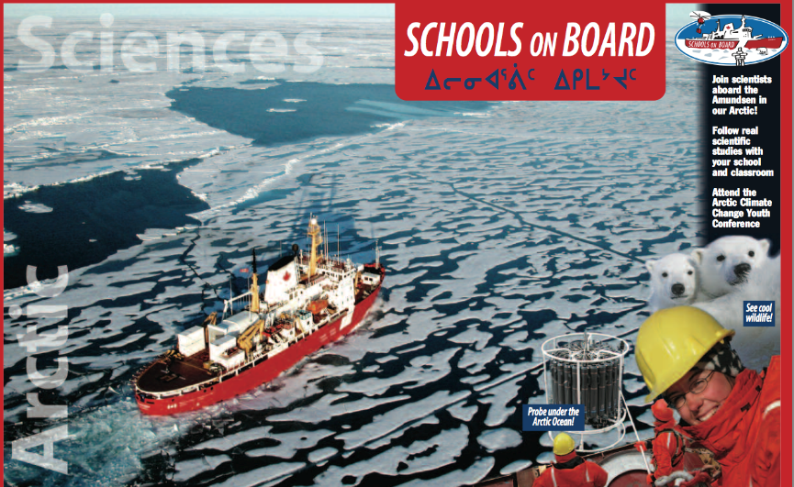
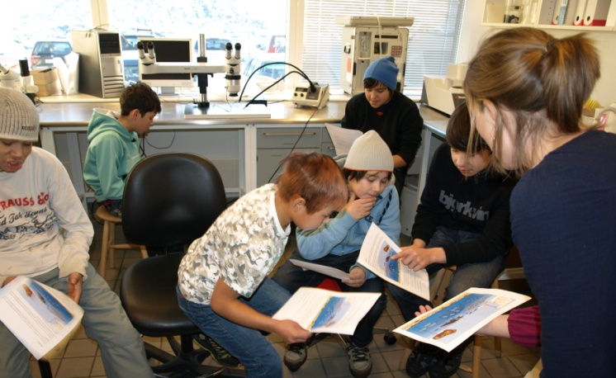
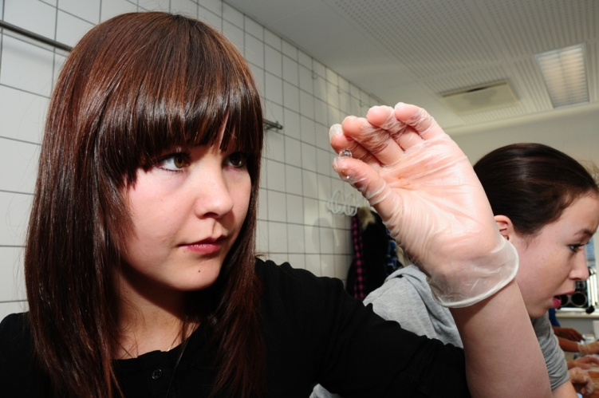
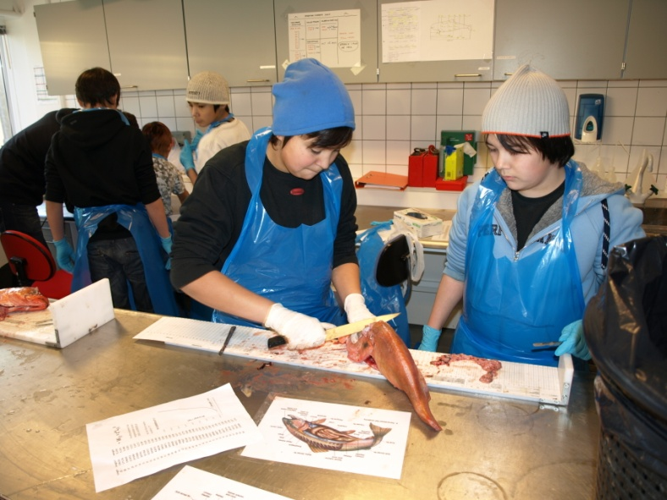
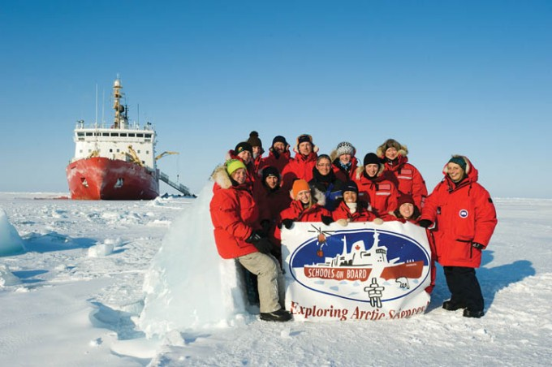
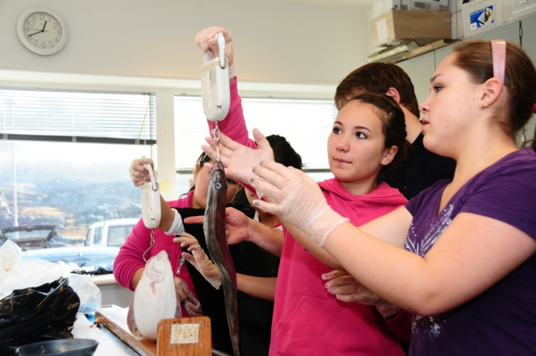
Outreach & Education

Slide 11
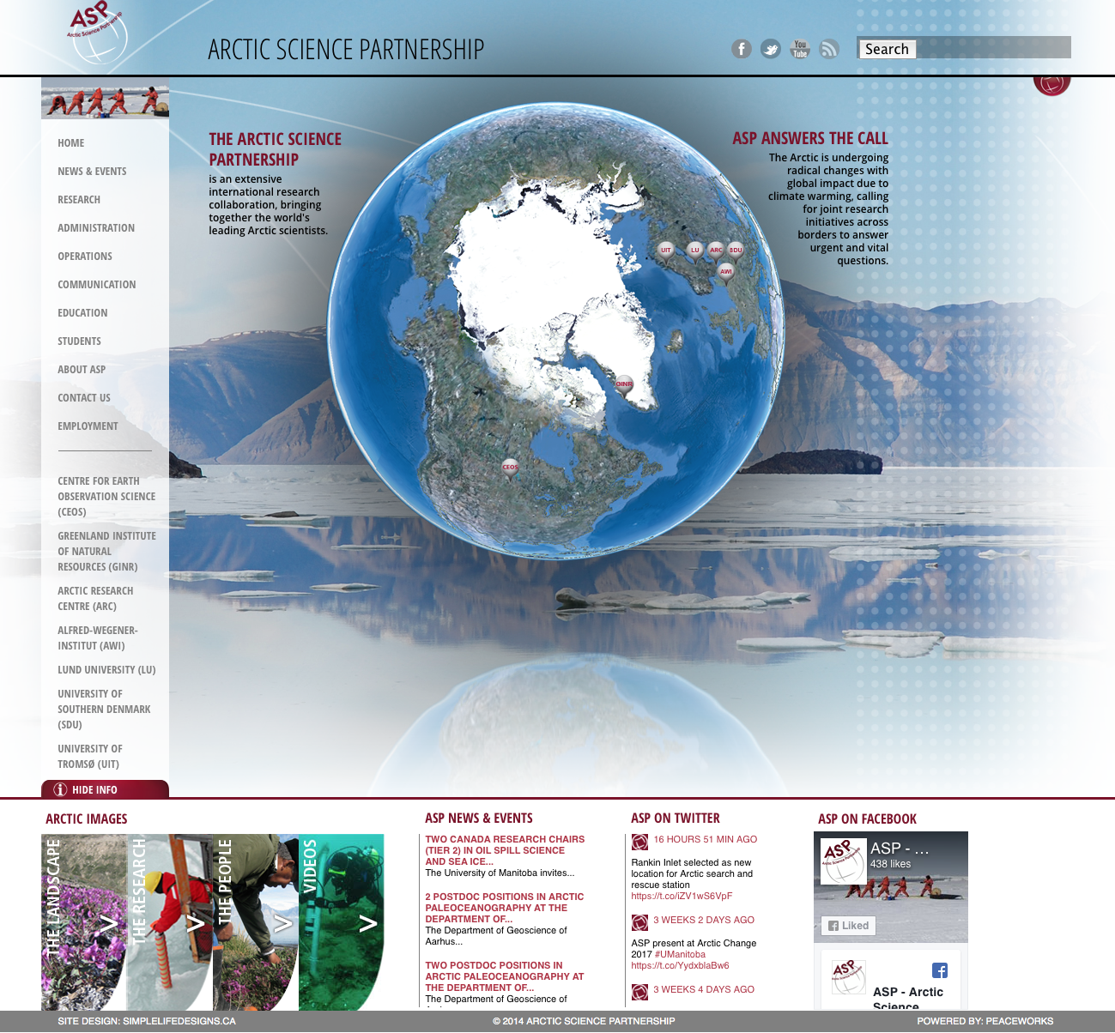
www.asp-net.org

