Slide 1

Logistics and Infrastructure
Egon Frandsen – Operations manager
Arctic Research Centre – Aarhus University
Peter Schmidt Mikkelsen - Lead Coordinator
Greenland Institute of Natural Resources / Aarhus University
Arctic Frontiers, January 23, 2018

Slide 2
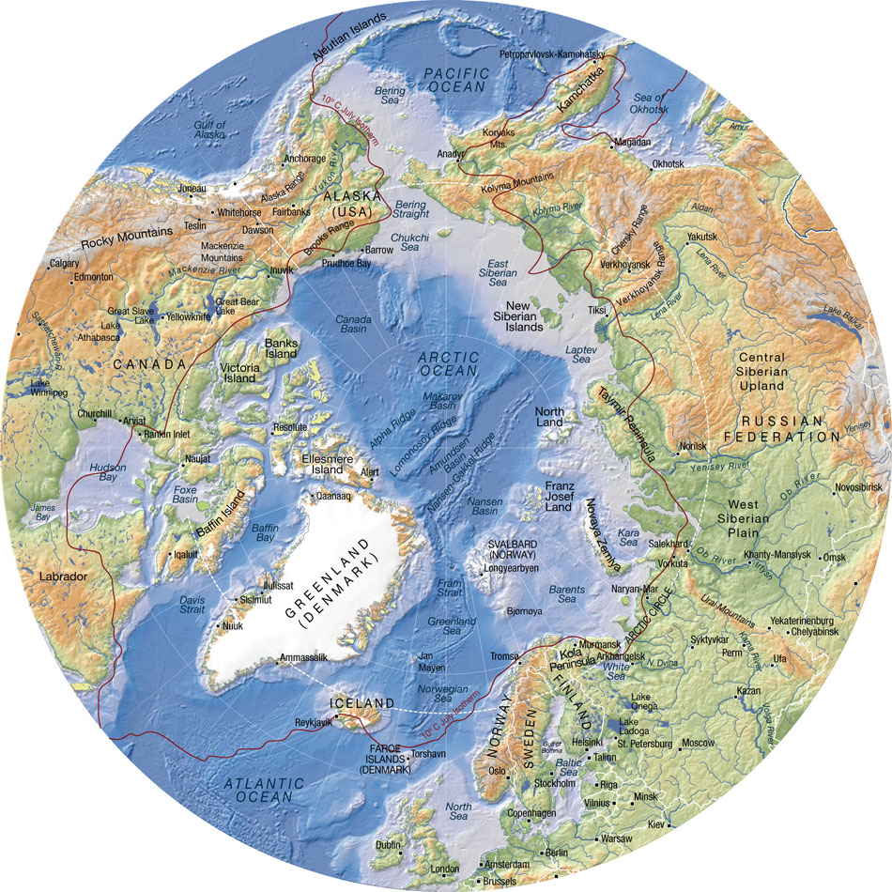
ASP Field Campaigns 2012-17
2012: Young Sound
ASP Start-up campaign
2013:
Nuuk – 26 projects in Nuuk area
SERF – 3 projects
2014:
Young Sound – 14 projects
SERF – 3 projects
Nuuk – 1 project
Cambridge Bay – 14 projects
Amundsen – 5 projects
2015:
VRS Station Nord – 18 projects
Young Sound – 1 project
SERF – 3 projects
Amundsen – 7 projects
Green Edge – 2 projects
2016:
VRS Station Nord – 5 projects
Young Sound – 2 projects
SERF – 7 projects
Baffin Bay – 7 projects
Nuuk – 9 projects
Svalbard – 4 projects
Other projects – 7 projects
2017:
VRS Station Nord – 7 projects
Young Sound – 2 projects
SERF – 3 projects
Greenland Sea – 2 projects
Nuuk – 2 projects
Svalbard – 5 projects
Baffin Bay – 8 projects
Other projects – 3 projects
2013- 2017
2013- 2017
2013- 2017
2013- 2017
2016 2017
2015
2016 2017
2016 2017
2017
2013-2014
2016- 2017
2012
2014- 2017

Slide 3
Example of logistics
2014
2014:
Young Sound – 14 projects

Slide 4
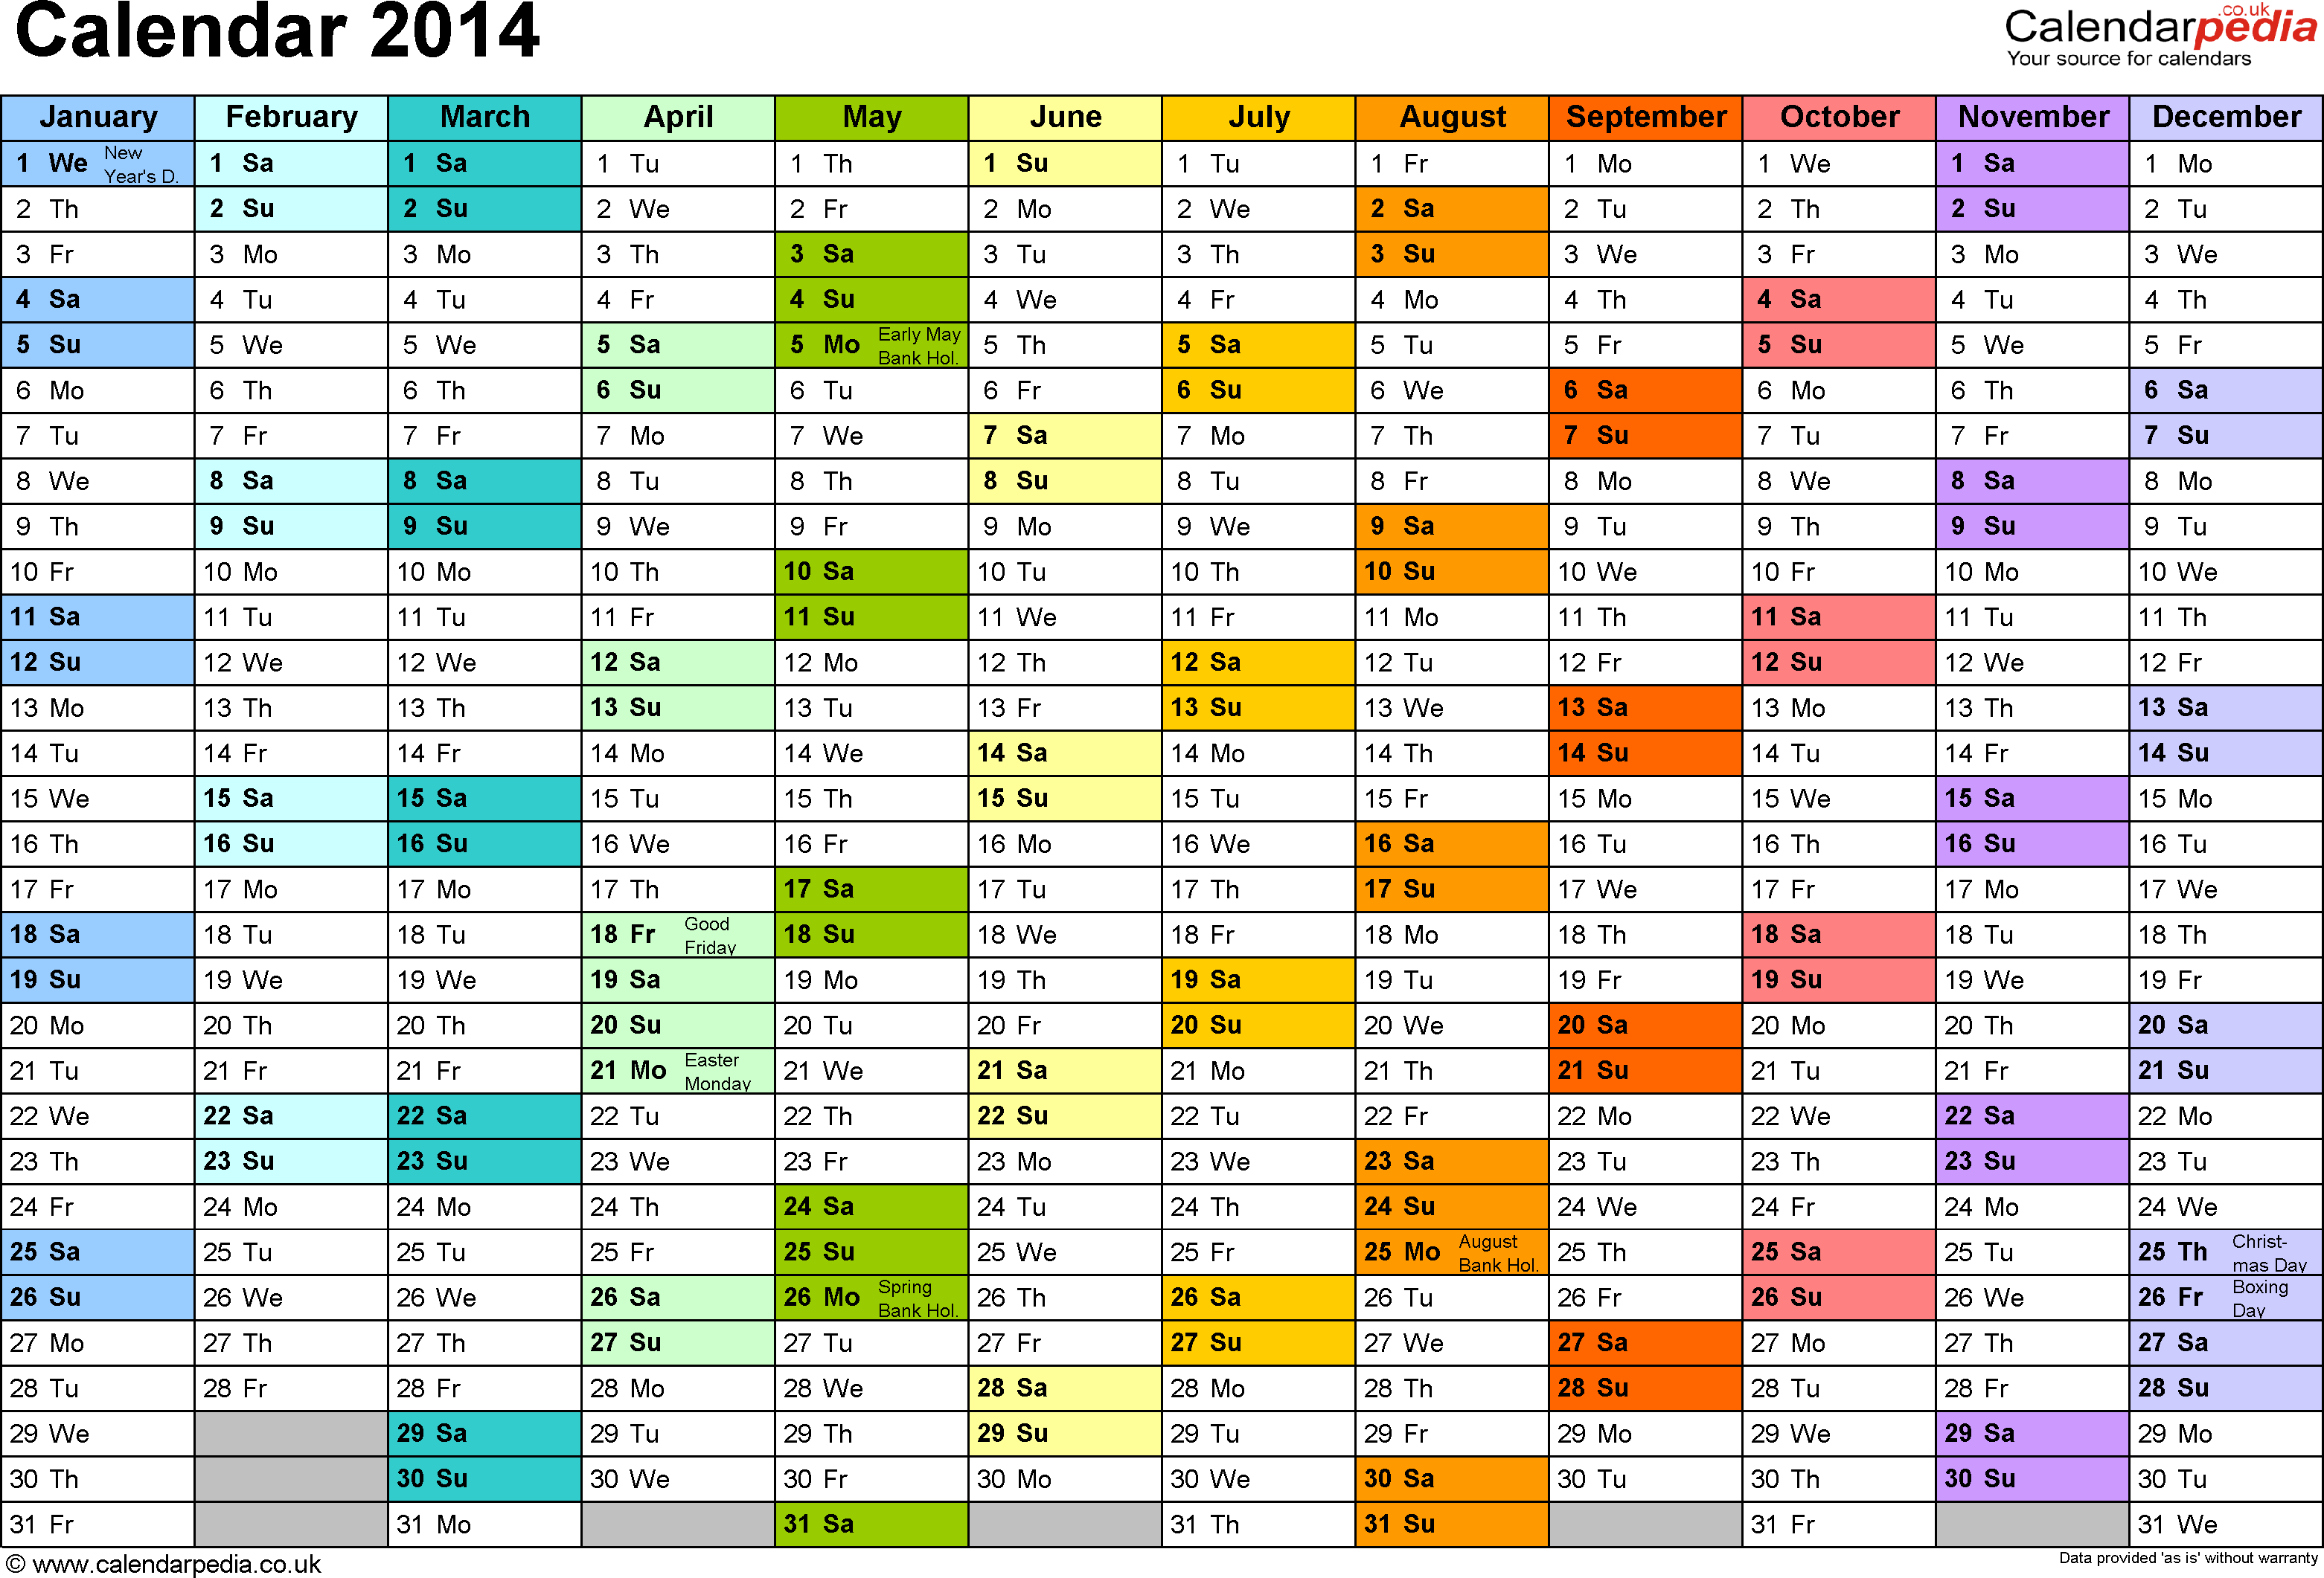
Field period 2014 – 9 legs
Leg 8 – 30. April – 14. May
Leg 1 – 30. April – 21. May
Leg 2 – 21. May – 11. June
Leg 5 – 23. July – 13. August
Leg 6 – 3. - 17. September
Leg 9 – 9. July – 6. August
Leg 4 – 9 -23. July
Leg 3 – 11. June – 2. July
Leg 2 – 21. May – 11. June
Leg 7 – 24. September – 1. October

Slide 5
Statistics – 2014
People
  56 differents scientist during the season
  The scientists stayed about 1250 nights in the field
Cargo
  4.9 tons of cargo to Daneborg
    0.4 ton by ship
    3.7 tons by air
    0.8 ton cargo send by ship in 2013
  5.1 tons of cargo from Daneborg
    3 tons by ship
    2.1 tons by air

Slide 6
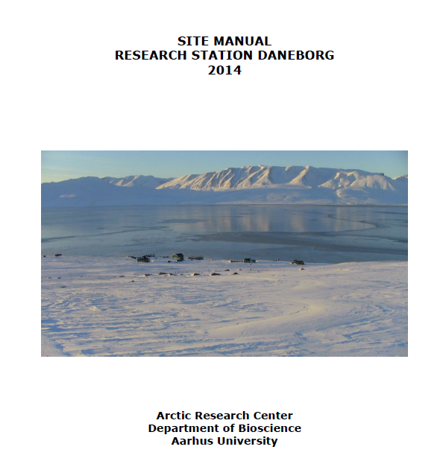
Site Manual for Daneborg

Slide 7
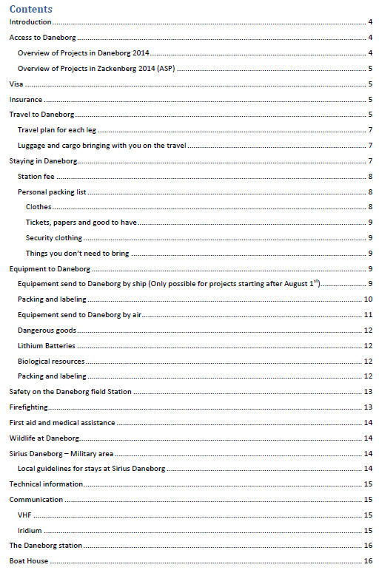
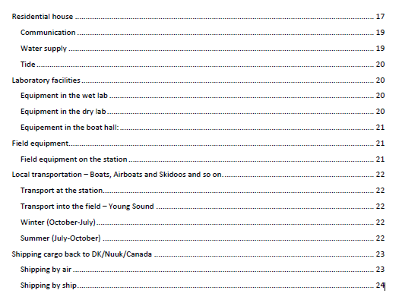

Slide 9

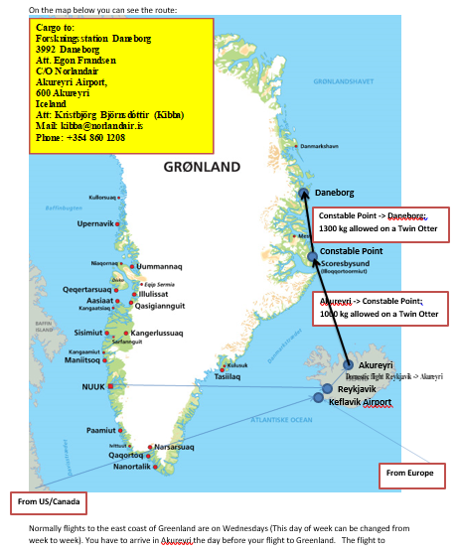

Slide 10
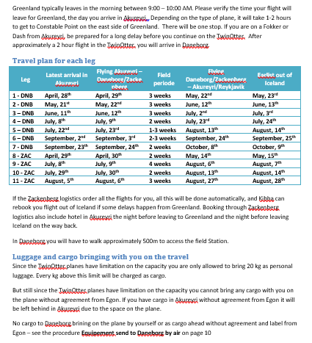

Slide 11
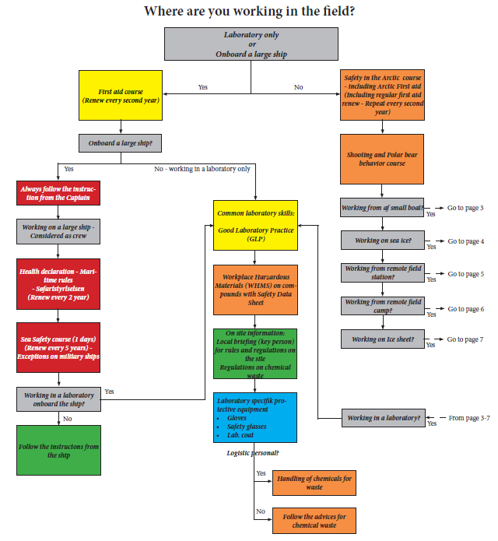
Safety in the field

Slide 12
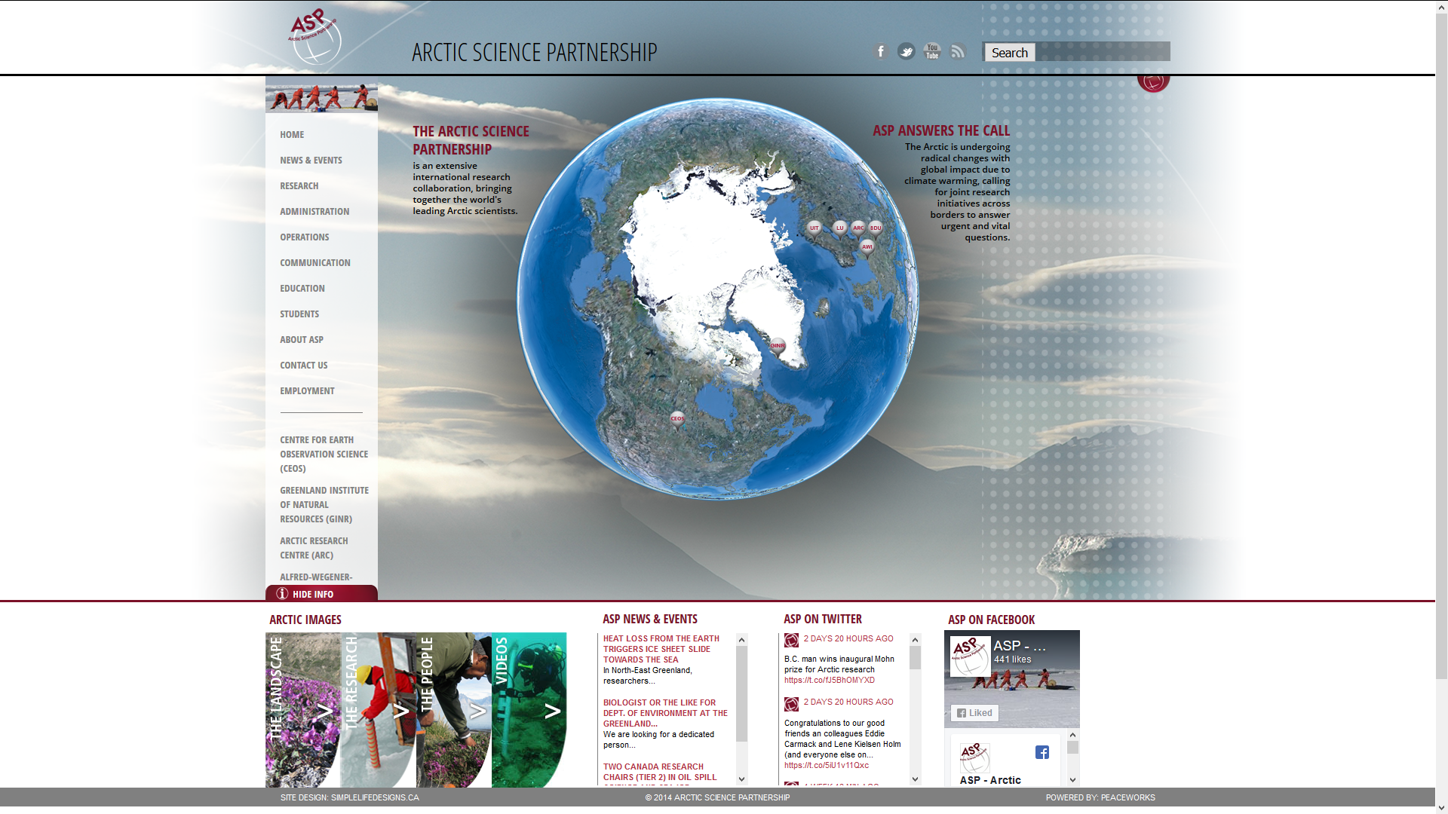
www.asp-net.org

Slide 13
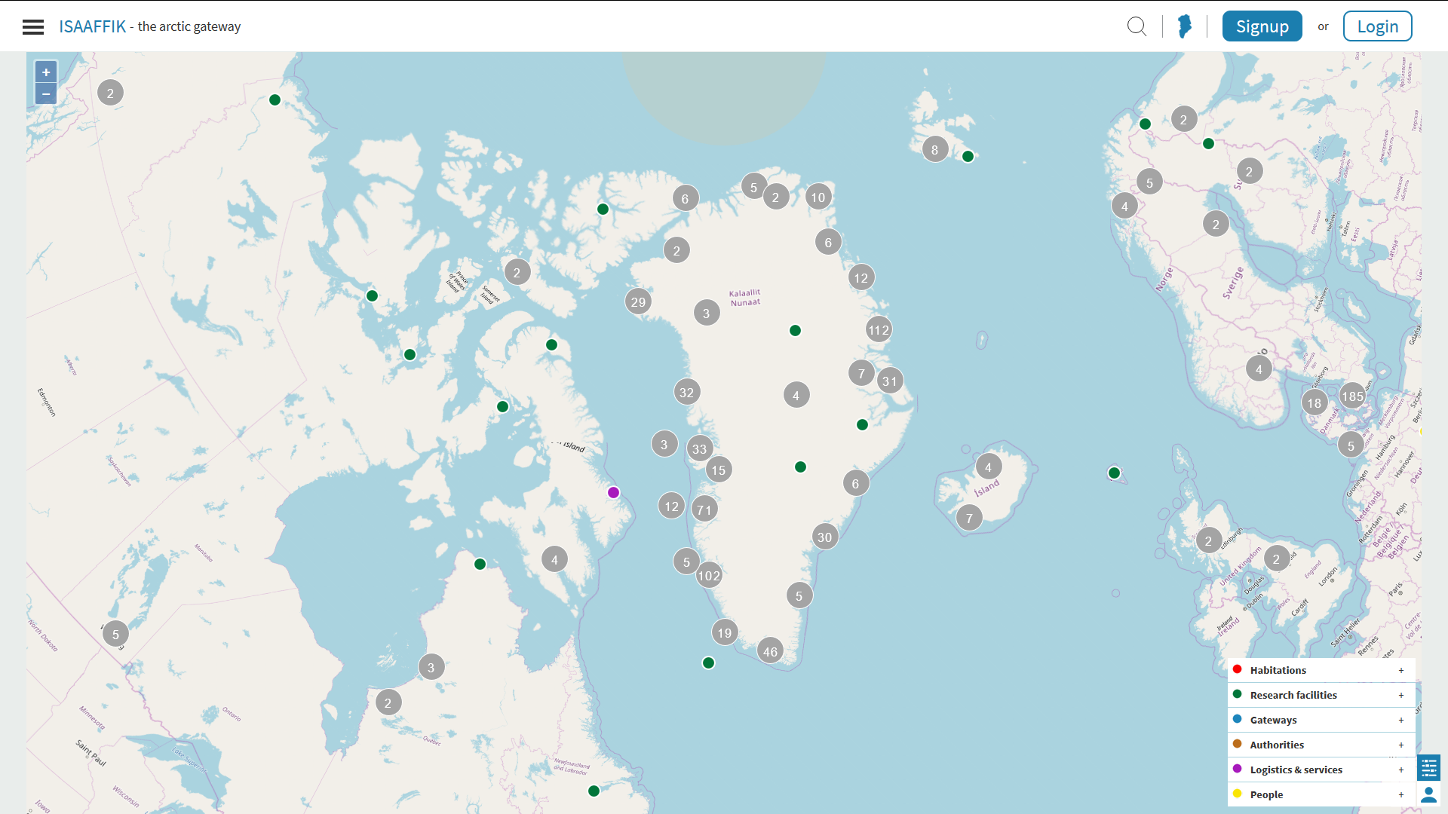

“Isaaffik”: Gateway in Greenlandic
A user driven web platform supporting research and collaboration in the Arctic within the Kingdom of Denmark and beyond.
ISAAFFIK is partnership cooperation between the universities, science ministries, Coast Guard in the Kingdom of Denmark.
International arctic researchers and institutions are welcome to join ISAAFFIK.
Isaaffik is operated by Aarhus University.
www.isaaffik.org

Slide 14
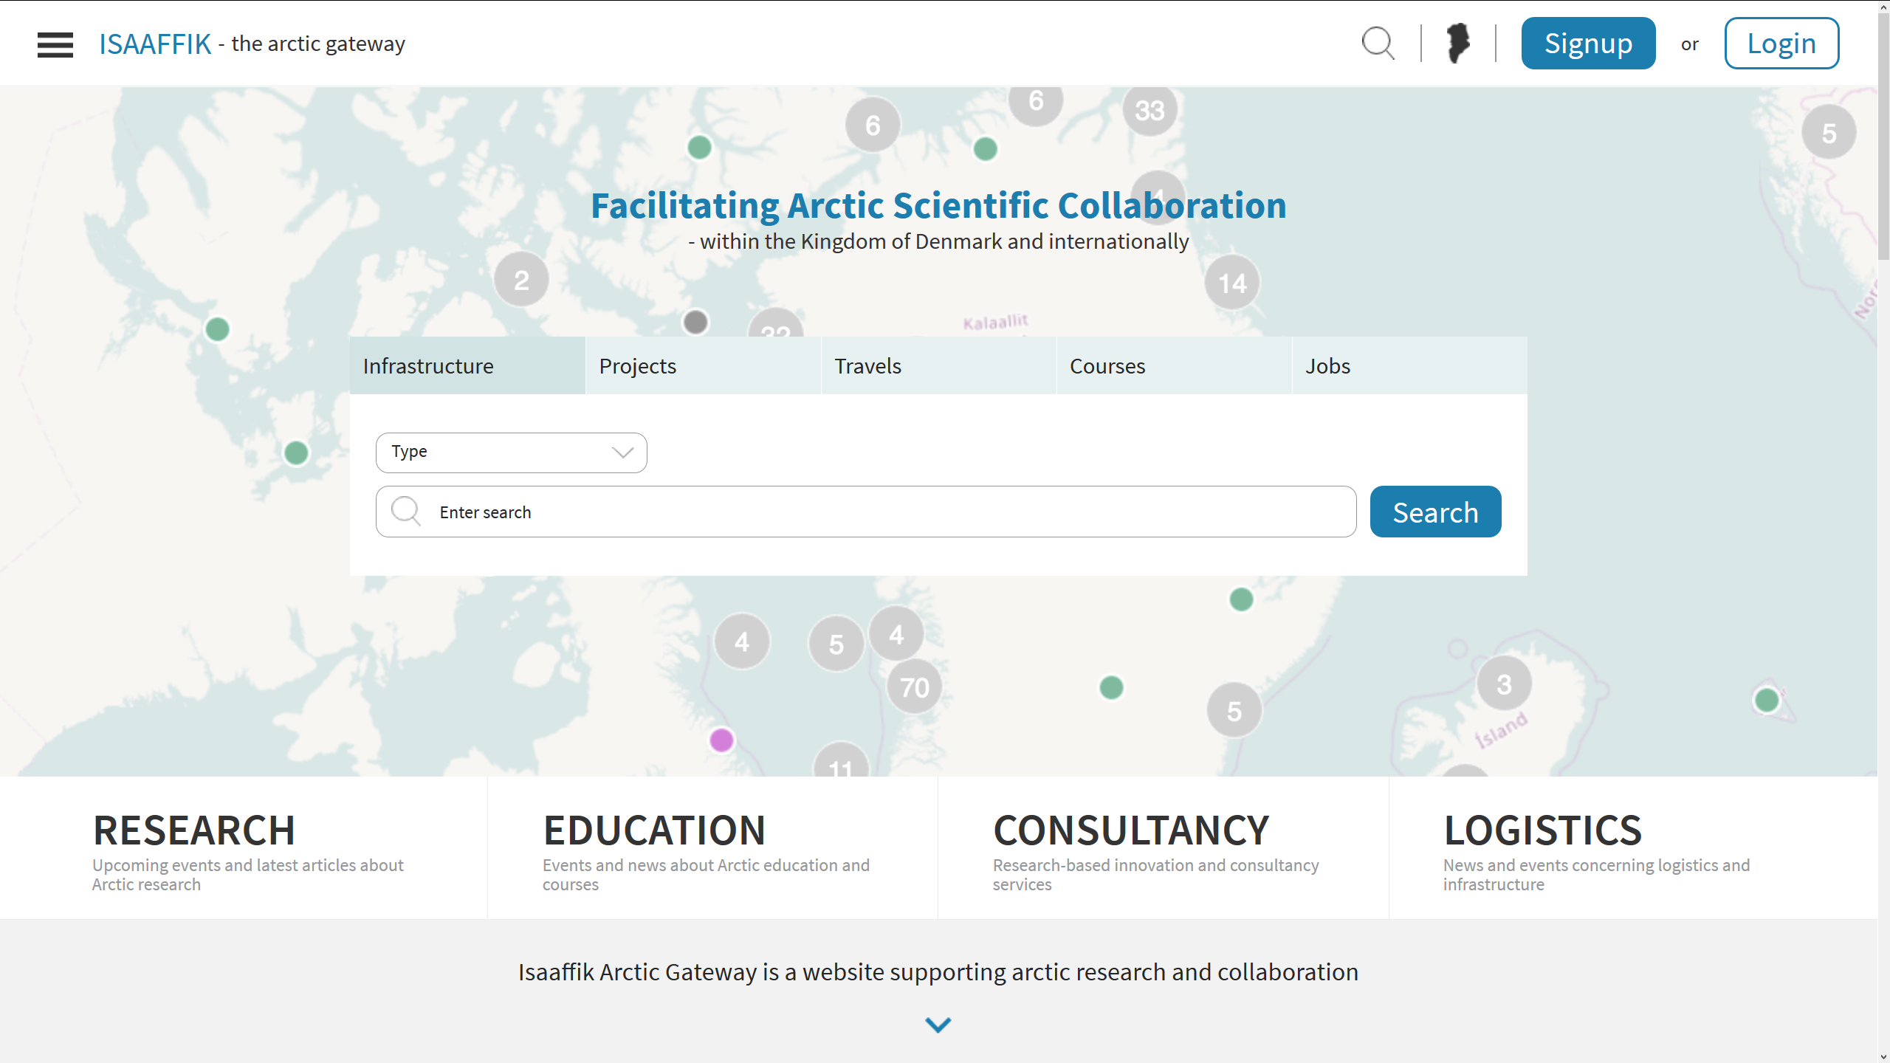
ISAAFFIK
ABOUT ISAAFFIK
ISAAFFIK is an independent website maintained by a partnership
It’s open to anyone with relation to Arctic scientific research
It’s a supplement to existing websites; not a replacement
It links to existing sources
Content is supplied and maintained locally by the partnership and other users
ISAAFFIK is about sharing, and it builds on the members’ contributions
www.isaaffik.org
  Looking for Arctic overview and collaboration?

Slide 15
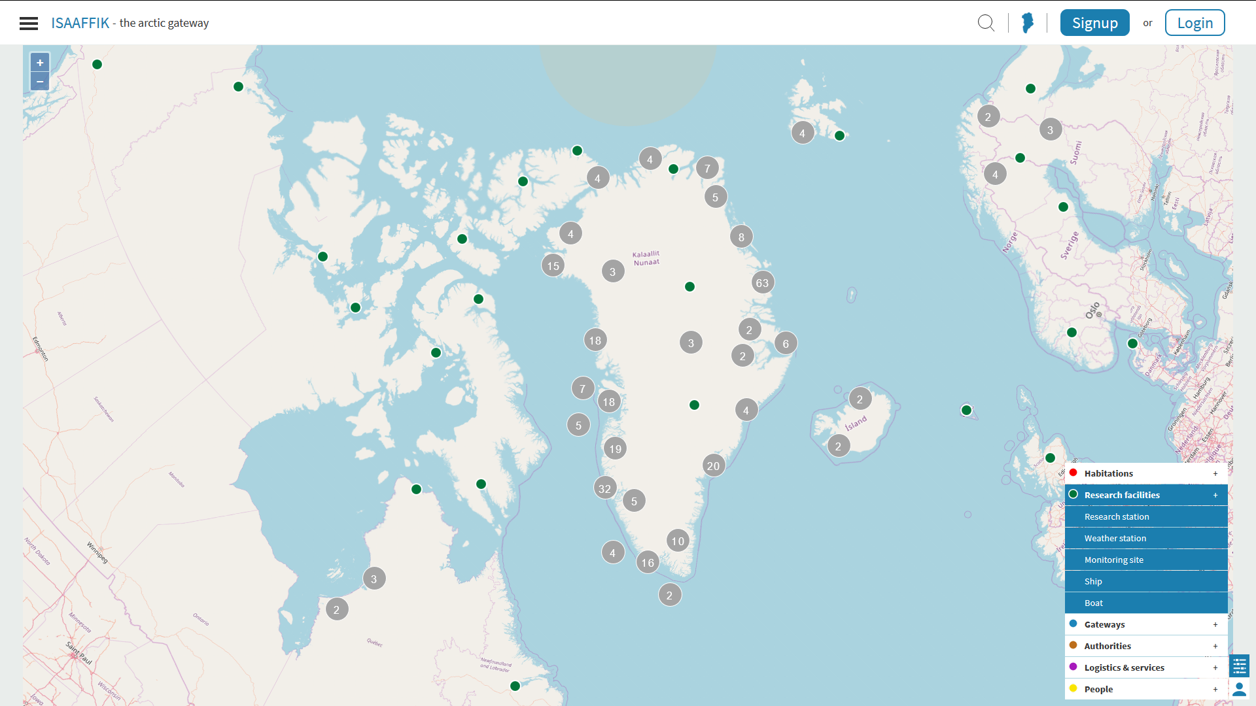
ISAAFFIK
WHAT CAN ISAAFFIK DO FOR YOU?
Whether you are a scientist, student, administrator, decision maker, politician, service provider or something else, ISAAFFIK is your tool to:
• Provide overview of Arctic infrastructure and who’s working with what, where, and when
• Facilitate collaboration of research, education, consultancy, infrastructure & logistics
• Help you to cut costs on your Arctic travel budget, e.g. by split chartering
• Increase your safety during fieldwork by making your projects and whereabouts visible to authorities and other parties
• Give you an overview of Arctic courses and educational programs available
Keep you updated on the latest Arctic news
www.isaaffik.org
  Looking for habitations, research facilities, gateways, authorities, logistics & services or people?

Slide 16
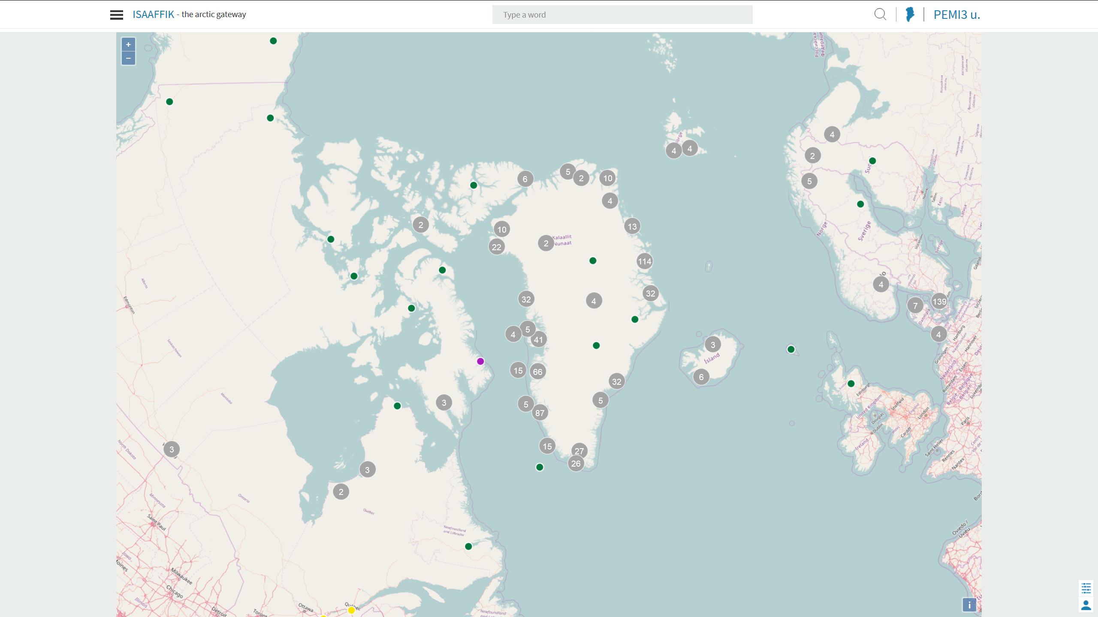
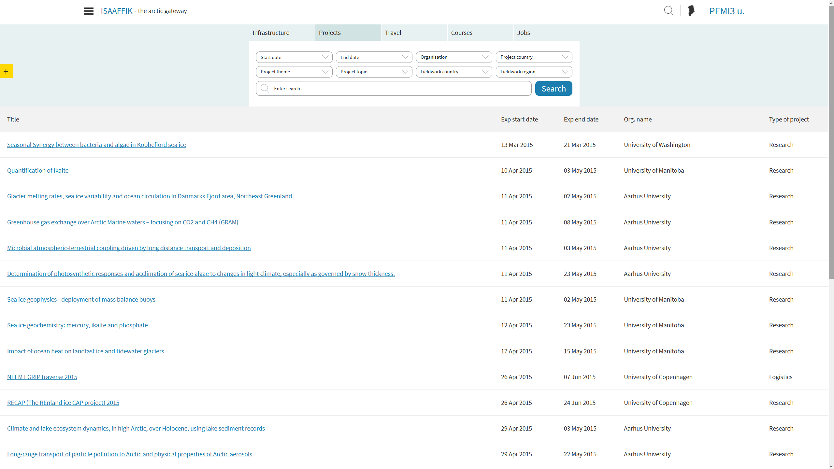
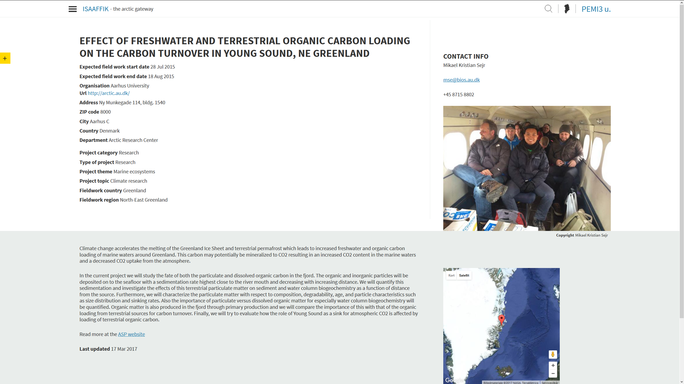
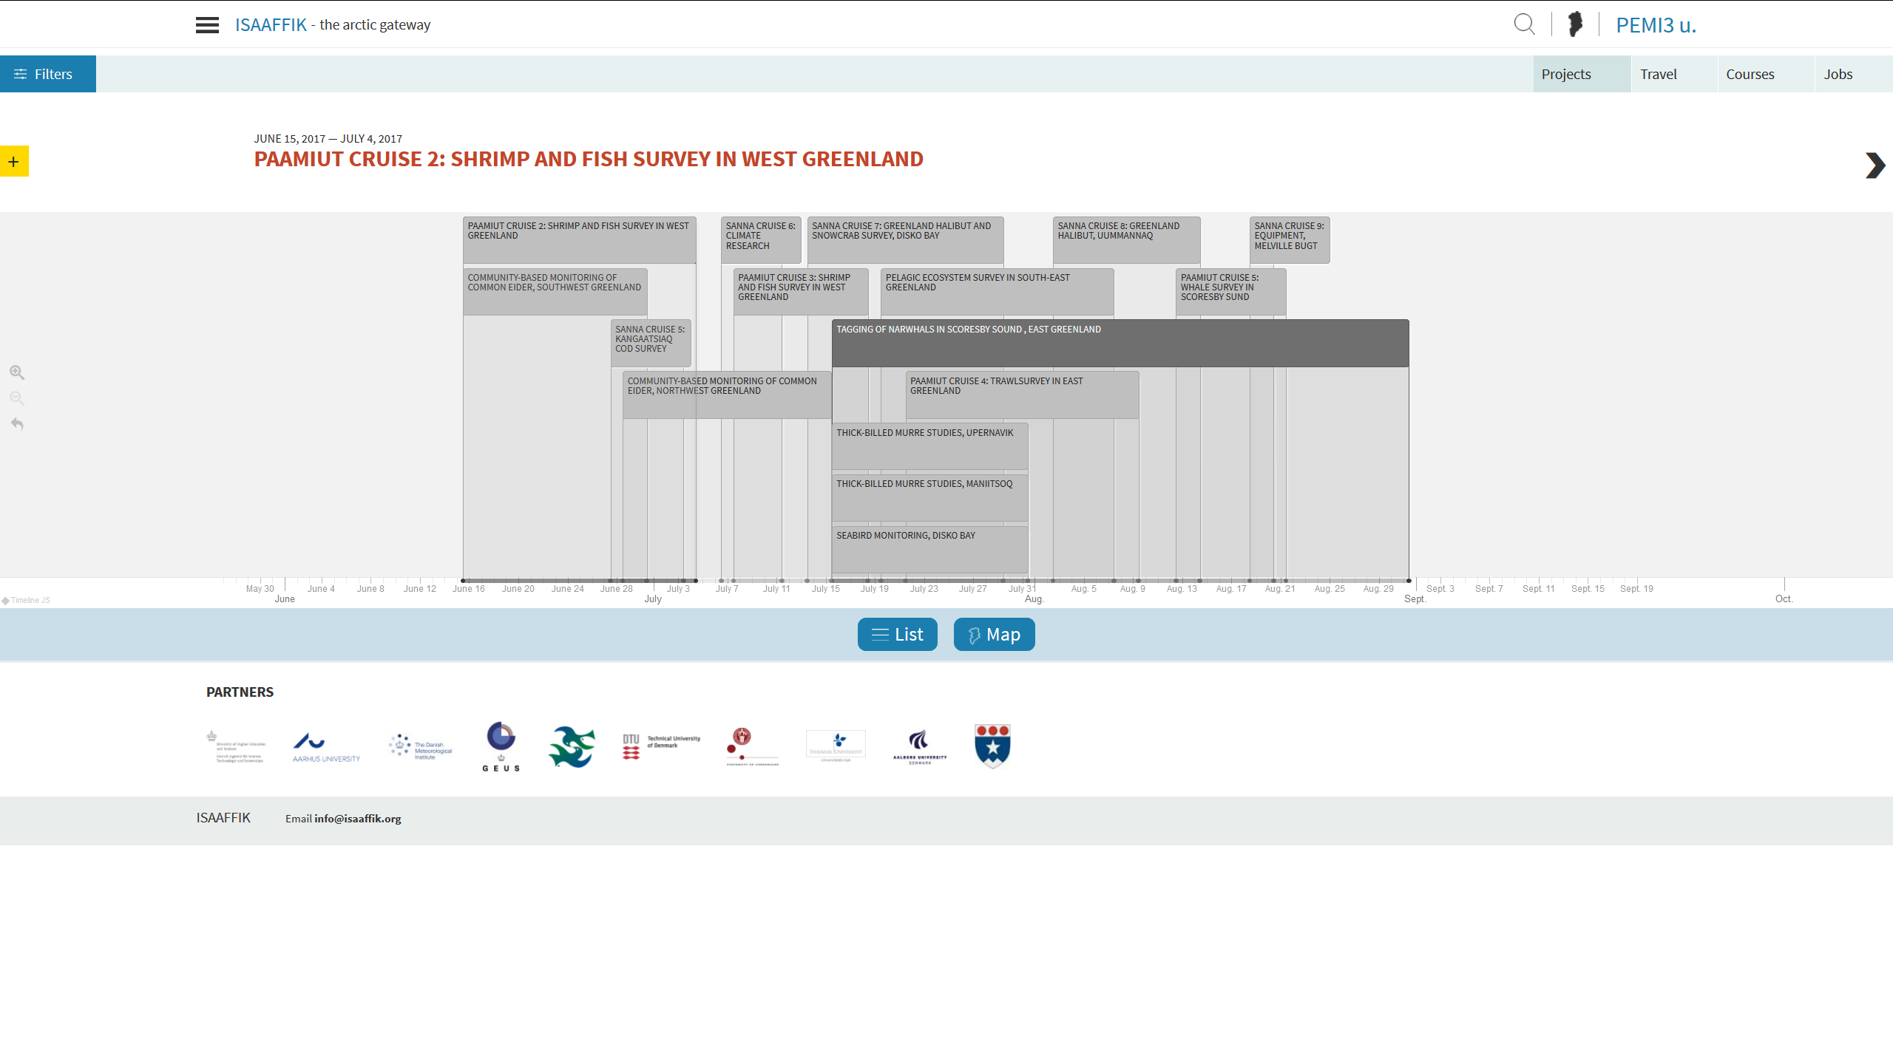
ISAAFFIK
  Overview on a map (where)
  Choose the kind of overview that suits you best
  Overview on a list
  In details
  Overview on a timeline (when)

Slide 17
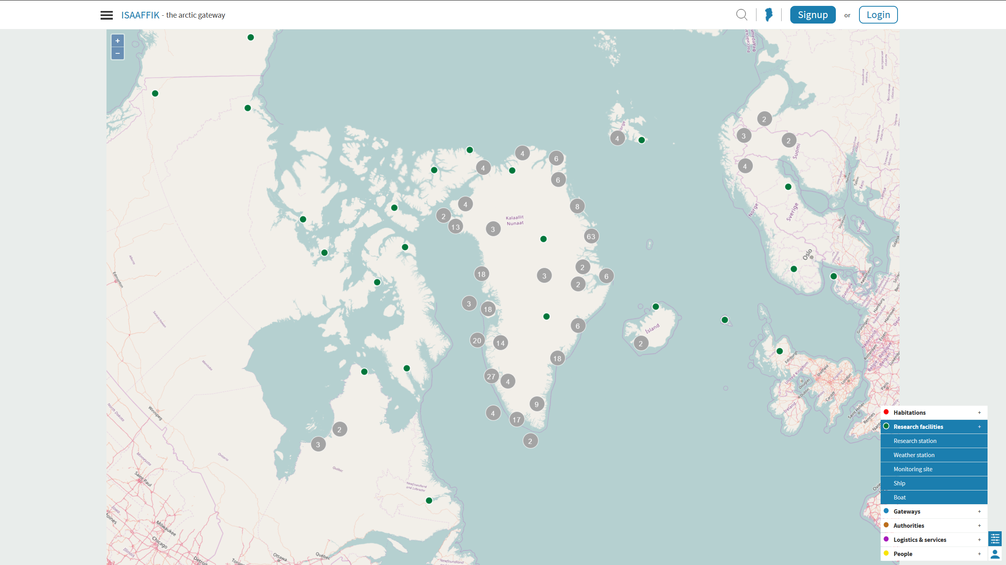

Slide 18
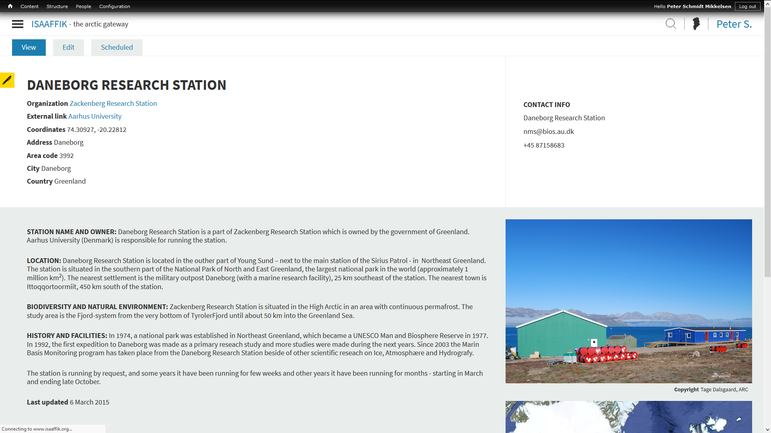

Slide 19
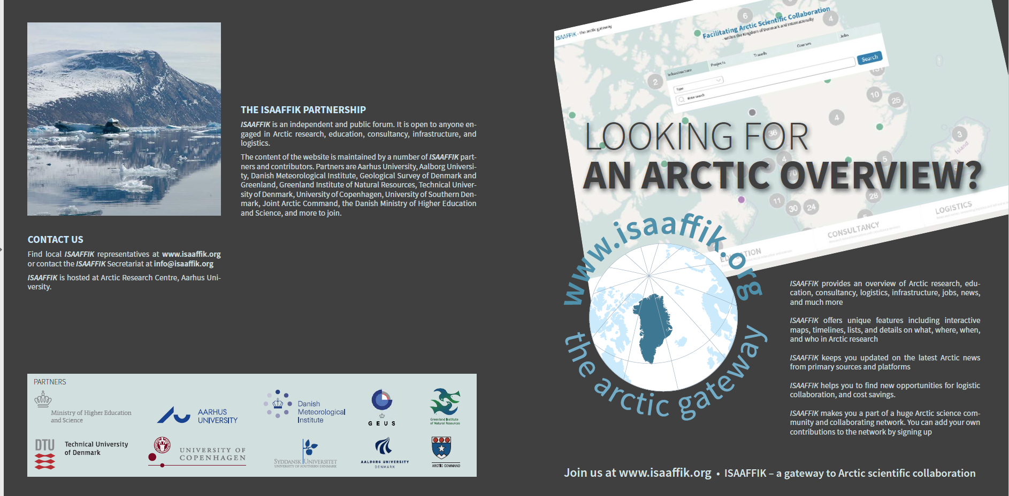
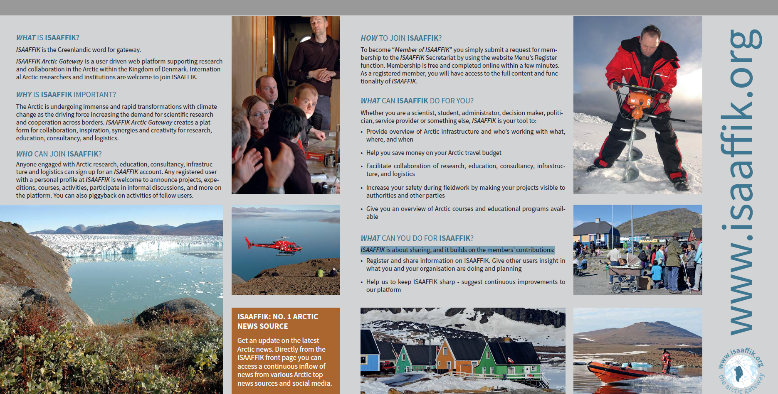

ISAAFFIK
  Help us to make ISAAFFIK even better - join us at
  www.isaaffik.org
www.isaaffik.org

Slide 20
Thank you…

