Slide 1


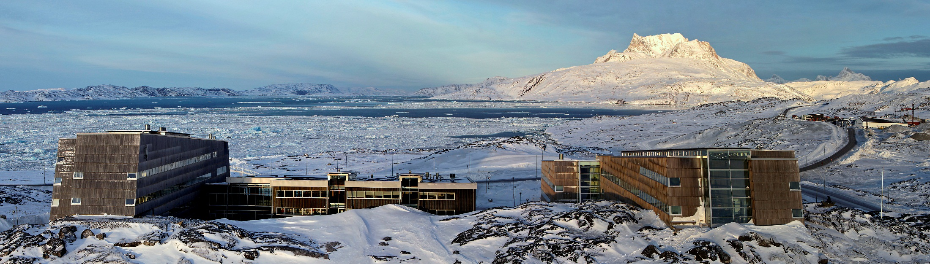

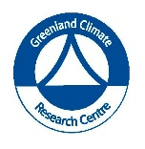

ASP activities 2016
Pinngortitaleriffik
Greenland Institute of Natural Resources
Grønlands Naturinstitut
Greenland Institute of Natural Resources
Presented by
Malene Simon, Head of Greenland Climate Research Center

Slide 2
Dept. of Fish and Shellfish
Pinngortitaleriffik
Greenland Institute of Natural Resources
Grønlands Naturinstitut
Survey activities:
1. Offshore East and West Greenland with Paamiut
  On the contineltal shelf (down to 600 meter)
  Deep water 600 – 1100 meter for Greenland halibut
2. Inshore surveys in West Greenland with Sanna
  Atlantic Cod in Sisimiut and Nuuk – and new survey effort in 2017 in Maniitsoq, Kangatsiaq and Disko
  Greenland Halibut in Disko Bay, Uummannaq and Upernavik
3. Pelagic survey
  Mackrel in East Greenland since 2014 (chartret vessel)
4. Other survey activities in Greenland water
  German survey on cod with Walter Herwig since 1982
  Islandic surveys on Capeline survey since 1978

Slide 3
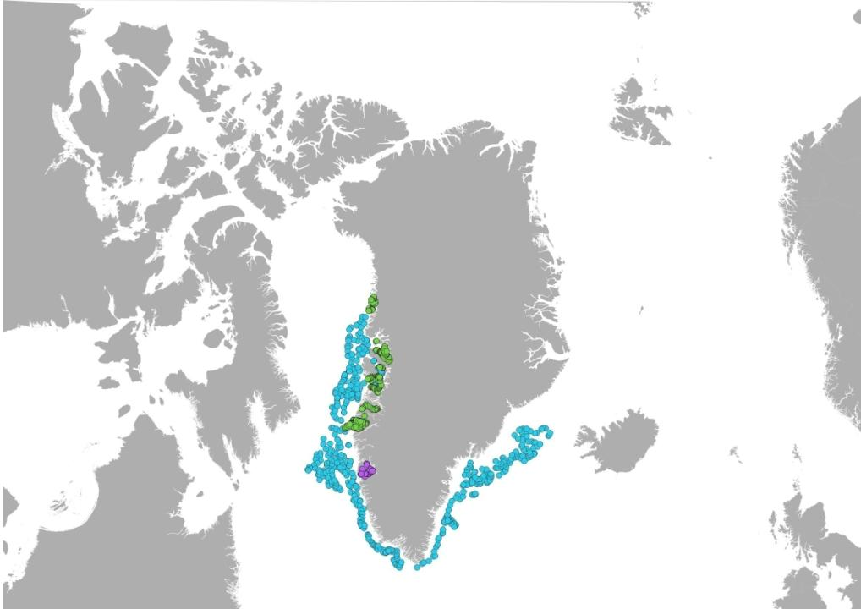
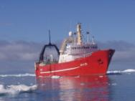
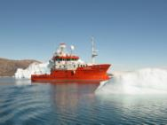
Dept. of Fish and Shellfish
Pinngortitaleriffik
Greenland Institute of Natural Resources
Grønlands Naturinstitut
Approx. 1 000 stations/year

Slide 4
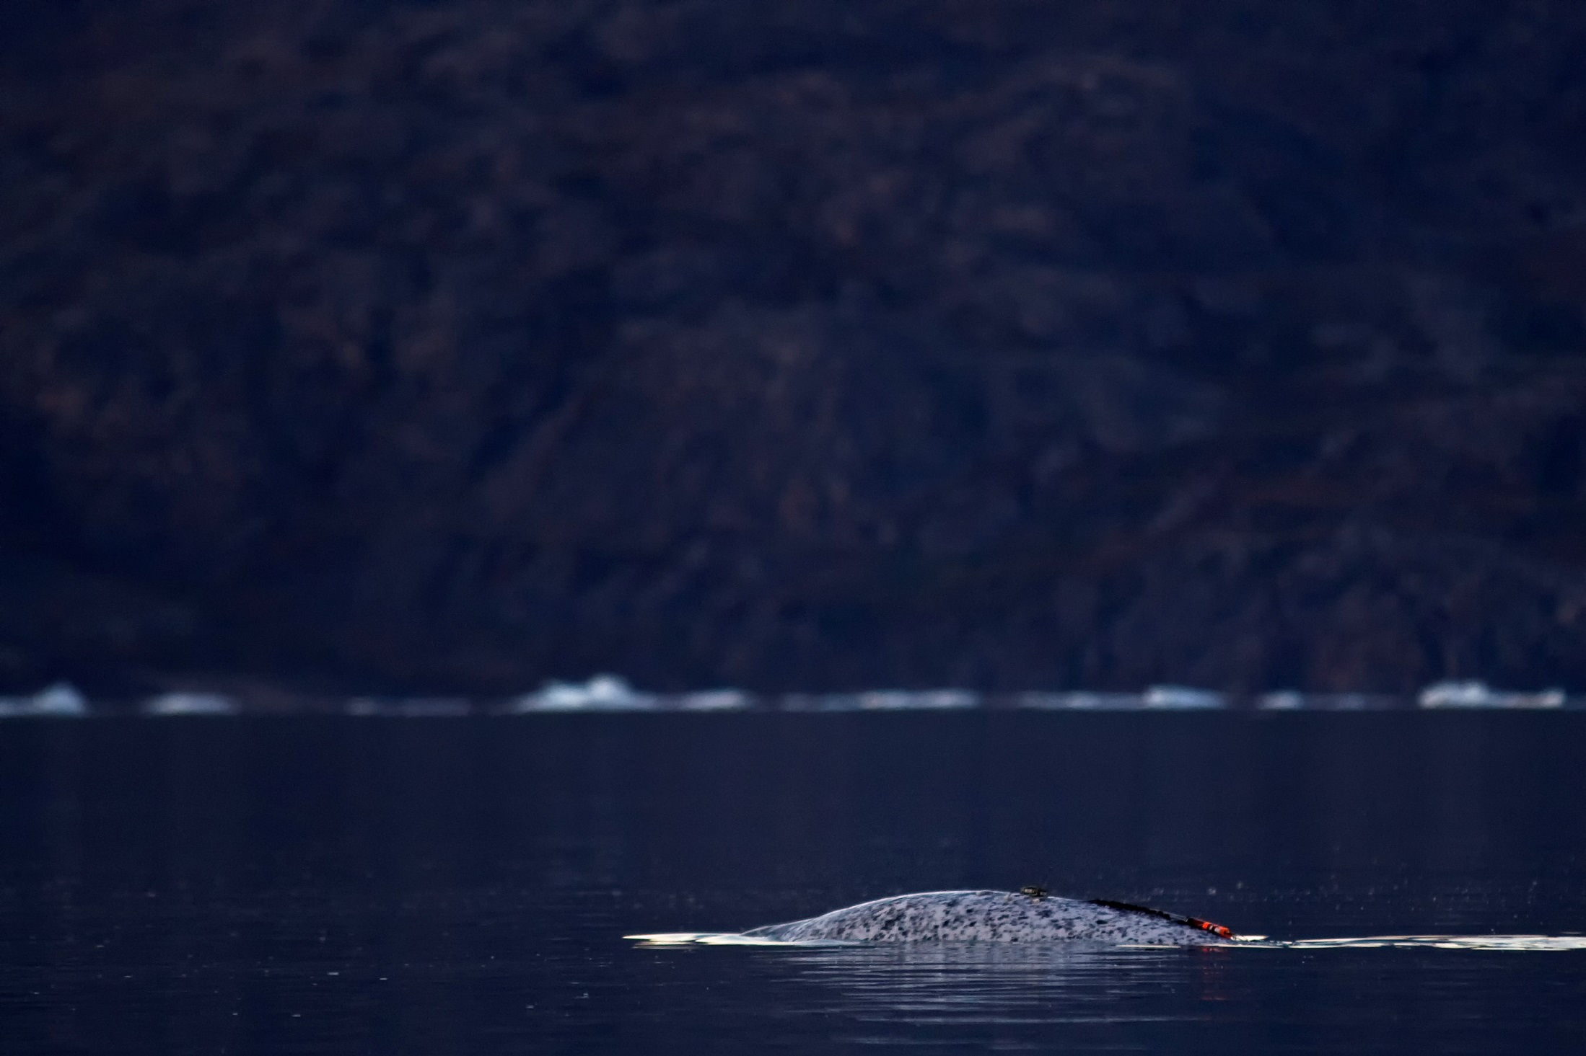
Dept. of Birds and Mammals 2016
Pinngortitaleriffik
Greenland Institute of Natural Resources
Grønlands Naturinstitut
Pinngortitaleriffik
Greenland Institute of Natural Resources
Grønlands Naturinstitut
Aerial survey of narwhals and baleen whales
East Greenland – Mads Peter Heide-Jørgensen & Rikke G. Hansen

Slide 5
Dept. of Environment and Mineral Resources
Pinngortitaleriffik
Greenland Institute of Natural Resources
Grønlands Naturinstitut
Field work
NuukBasic/BioBasis May to November
North East Greenland, Ella Ø August

Slide 6
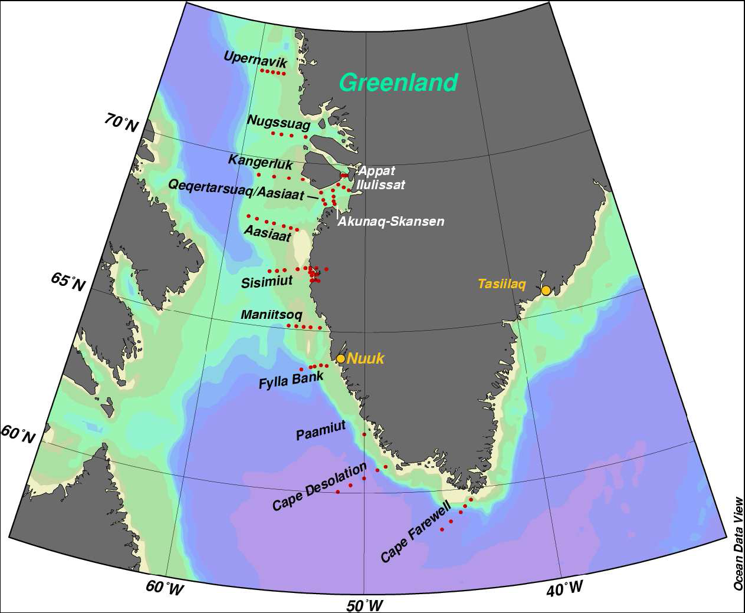
Baffin Bay 2016
Pinngortitaleriffik
Greenland Institute of Natural Resources
Grønlands Naturinstitut
The West Greenland coastal transect 2016
July-August.
CTDs
Platform: Tulugaq
Cape Farewell to Ilulissat
Lead: John Mortensen, GCRC

Slide 7
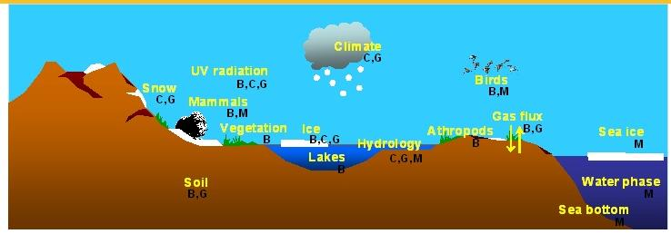
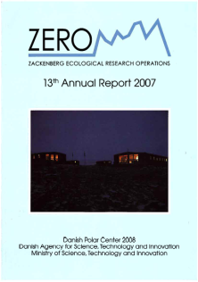
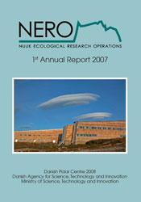
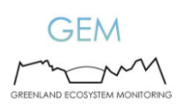
Greenland Ecosystem Monitoring
Pinngortitaleriffik
Greenland Institute of Natural Resources
Grønlands Naturinstitut
  A cross-diciplinary baseline study of climate change effects on marine and terrestrial ecosystems in high-Arctic Northeast Greenland (Zackenberg) and in sub-Arctic West Greenland (Nuuk).
  3500 parameters are monitored annually.
www.g-e-m.dk

Slide 8
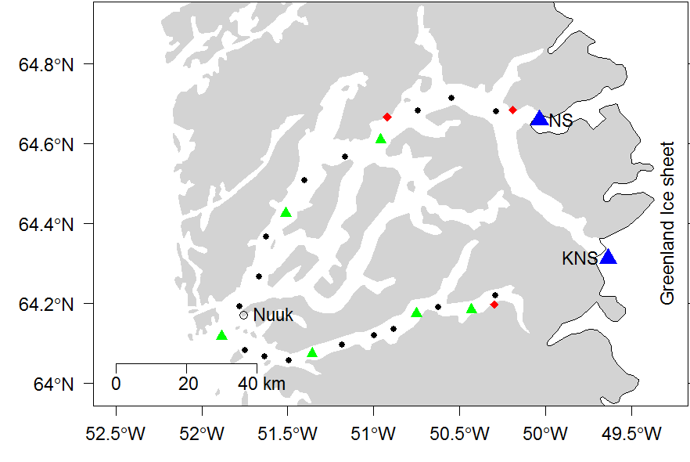
Carbon cycling in fjords impacted by glacial meltwater input, Seasonal work.
L. Meire & J. Mortensen
Nuuk Fjord 2016
Pinngortitaleriffik
Greenland Institute of Natural Resources
Grønlands Naturinstitut
Nutrients and chlorophyll sampling on CTD stations
Process rates on Focus stations
Build up mooring network
CTD stations
Focus stations
Moorings

Slide 9
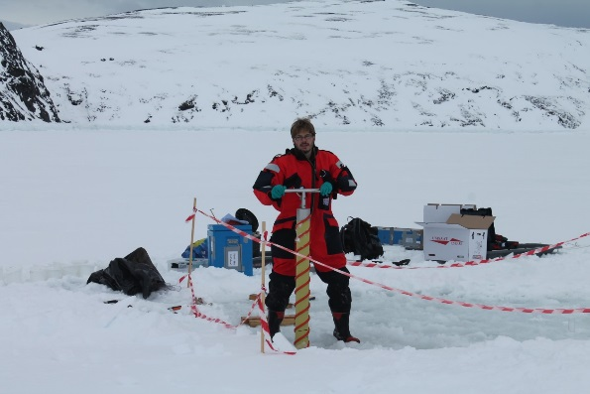
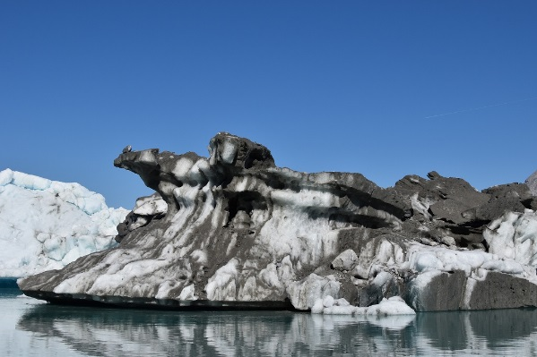
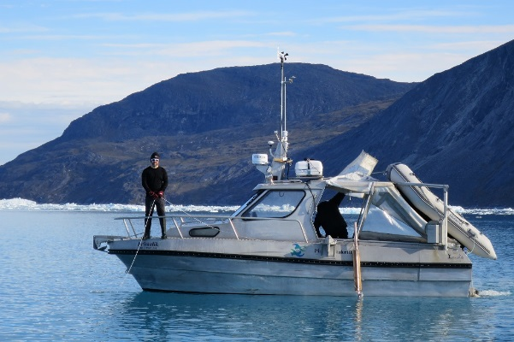
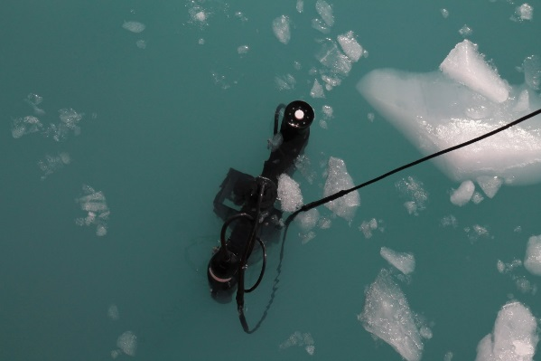
Nuuk Fjord 2016
Pinngortitaleriffik
Greenland Institute of Natural Resources
Grønlands Naturinstitut
The Role of icebergs, August 2016 (Leendert Vergeynst ARC and Lorenz Meire GINR)
Microbial degradation of oil polution, Feb-May 2016 (GINR, ARC)
Light dynamics in high latitude fjord, April – Oct 2016 (GINR, ARC, CEOS)
High resolution physical and biochemical variability, April – Oct 2016 (GINR, ARC, CEOS)
Humpback telemetry, photo id, DNA and ecology. May – Oct 2016 (GINR)

Slide 10
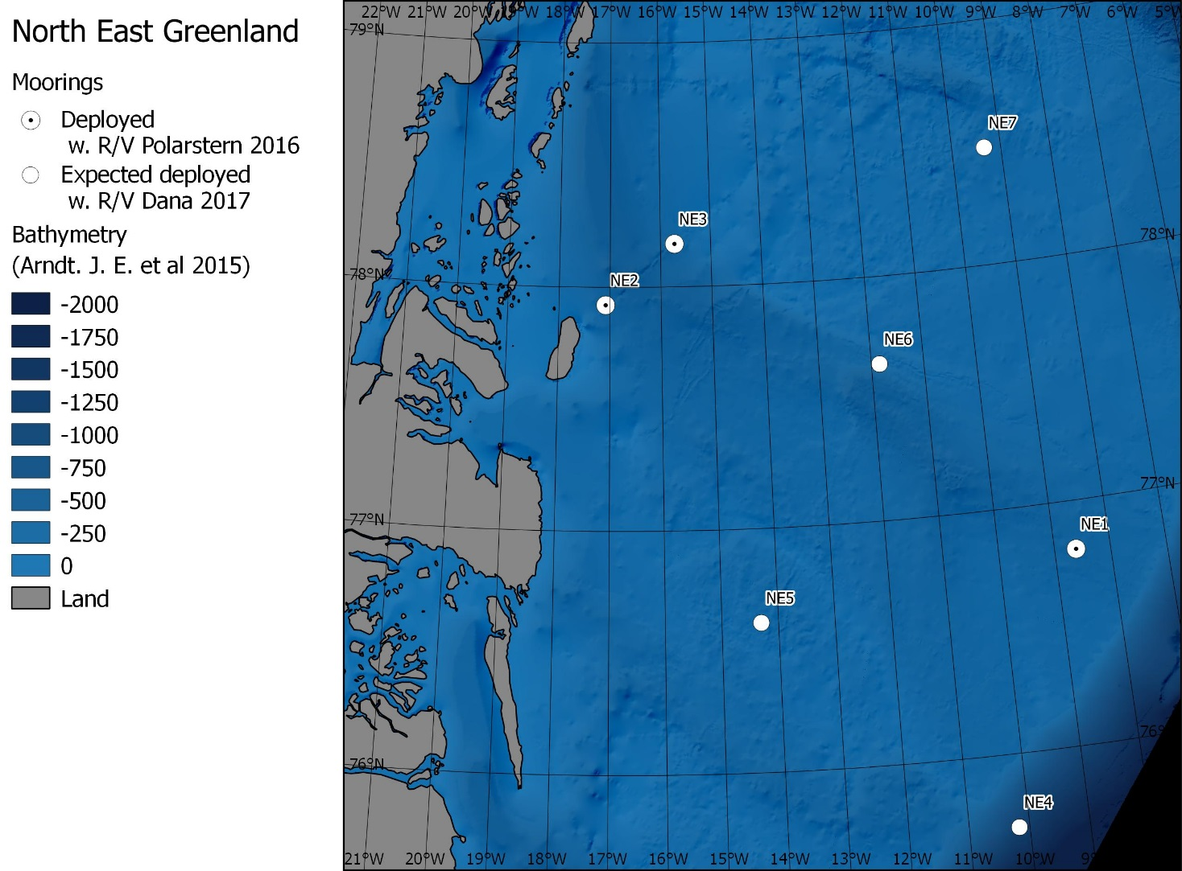
Moorings in Northeast Greenland
Pinngortitaleriffik
Greenland Institute of Natural Resources
Grønlands Naturinstitut
Passive Acoustic Monitoring of Marine Mammals (M. Simon, GCRC)
Oceanography (Wilken-Jon Von Appen, AWI)

Slide 11
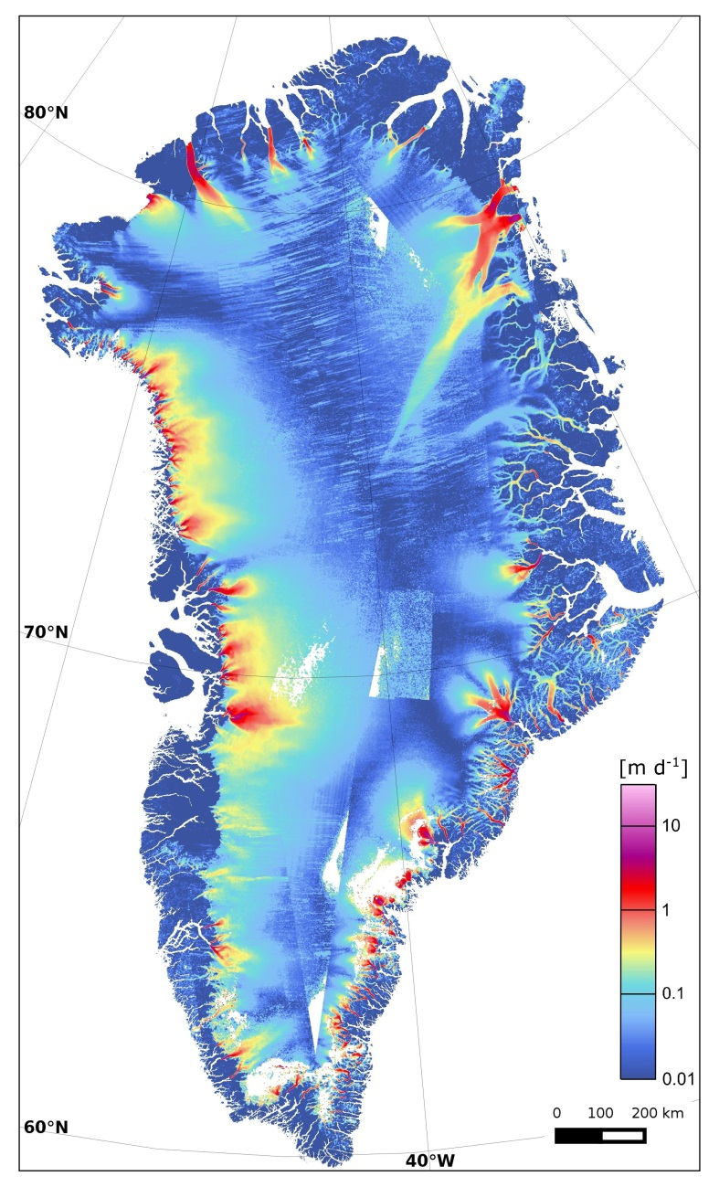
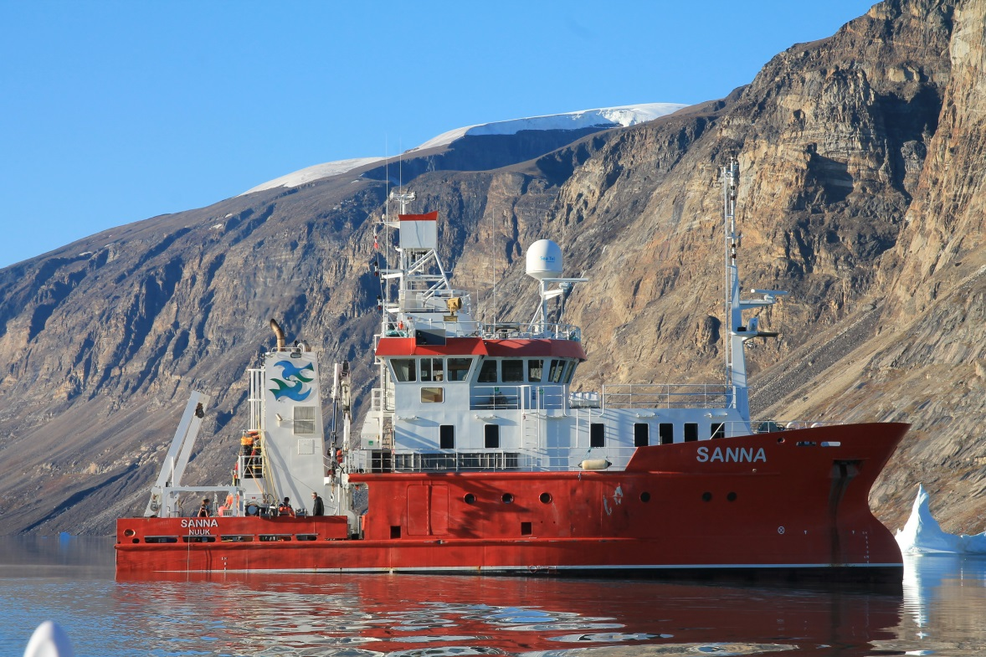
BASYS cruise –West Greenland
Pinngortitaleriffik
Greenland Institute of Natural Resources
Grønlands Naturinstitut
Transect studies in Ilulissat, Uummannaq ,
Upernavik and Kullorsuaq
August 2016
ARC and GINR scientists (Lead: S.Rysgaard, M. Sejr)

Slide 12
Education 2016
Pinngortitaleriffik
Greenland Institute of Natural Resources
Grønlands Naturinstitut
ASP related educational activities at the Greenland Institute of Natural Resources (GINR)
”Specialization in Arctic Climate and Environment” (February-July 2016 - Natural Science students)
“Introductory safety course” (GINR)
“Snow-covered sea ice” (5 ECTS - UoM)
“Climate forcing effects and adaptations in the Arctic” (10 ECTS - AU)
“Fishery and hunting in Greenland” (5 ECTS – GNIR & Ilisimatusarfik)
“Arctic Governance and sustainable development: social and environmental challenges” (5 ECTS - Ilisimatusarfik)
“Arctic marine ecosystems” (10 ECTS – GINR & AU)
  An annual marine climate effect monitoring cruise covering Godthåbsfjord-Fyllas Banke in May (Greenland Ecosystem Monitoring) is cooperating on combining student projects and marine climate effect monitoring
“Effects of climate change on Arctic ecosystems and societies” (5 ECTS) (July 2016 - Nordic Master/PhD students)
Part of the Atmosphere-Biosphere Studies (ABS) program
Focus on climate, ice and society
Interdisciplinary: natural and social sciences
2 weeks in Reykjavik and Nuuk
New Building

