Slide 1
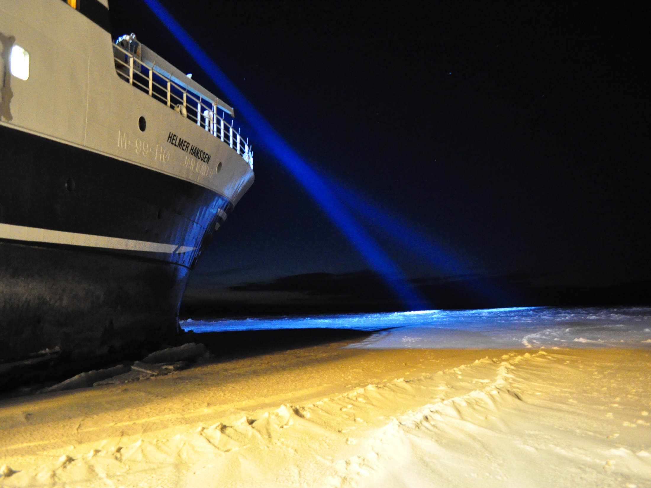


Polar Night cruises
Professor Jørgen Berge
(UiT The Arctic University of Norway, UNIS & NTNU)

Slide 2
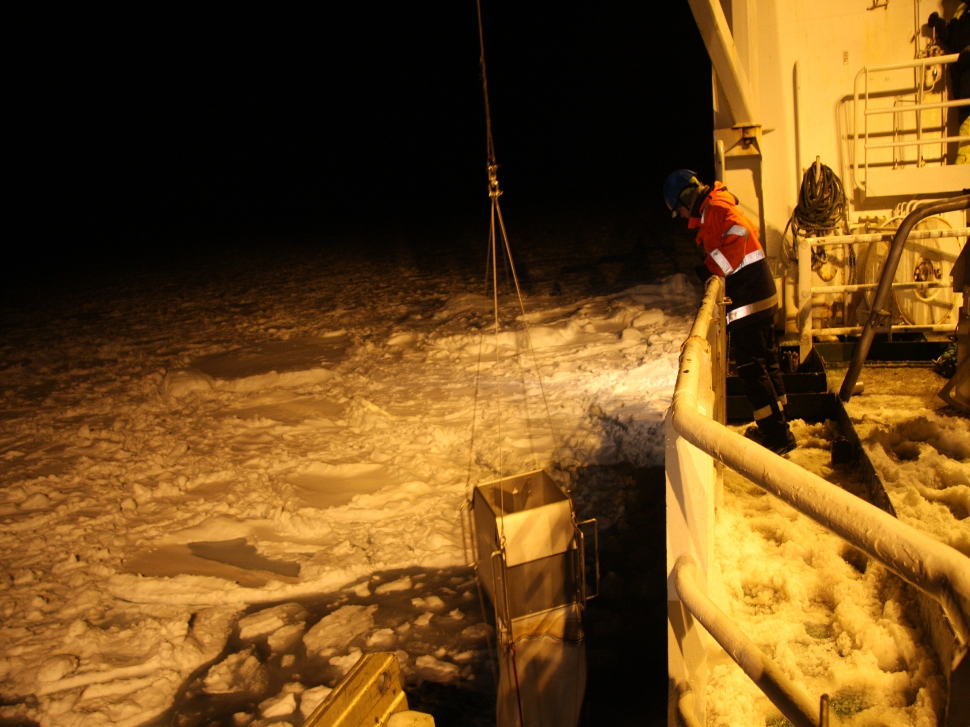
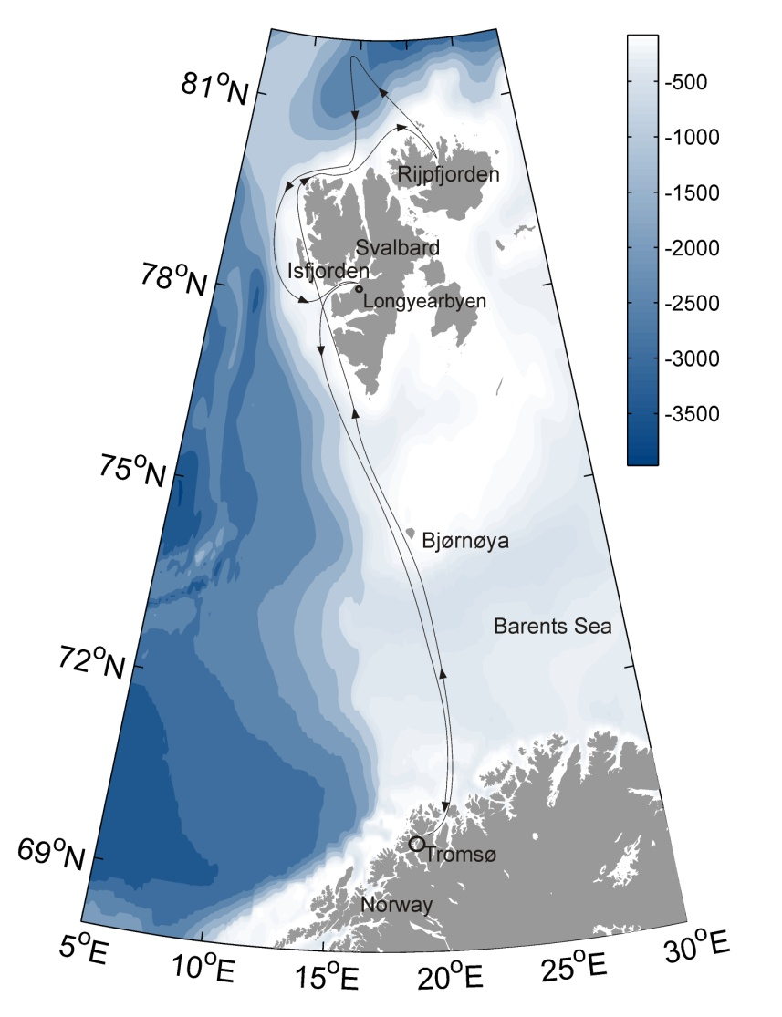
Polar Night Cruise
RV Helmer Hanssen
2012 - 2018

Slide 3
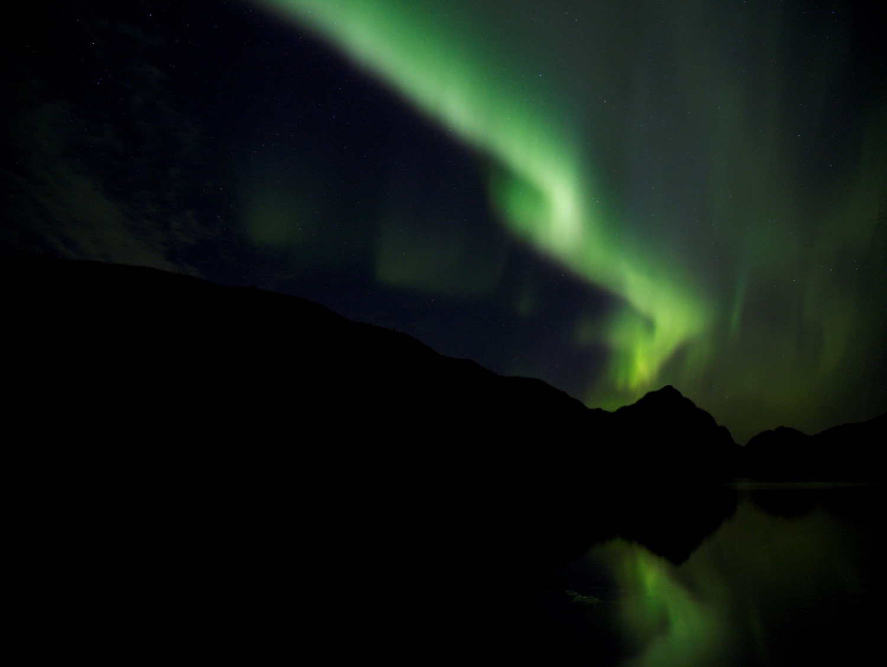
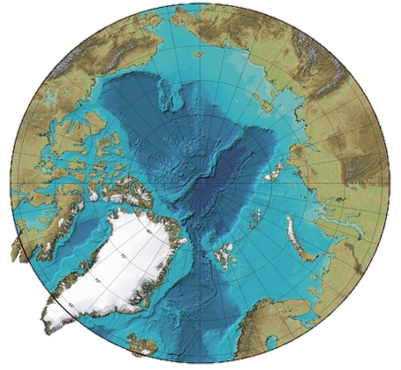
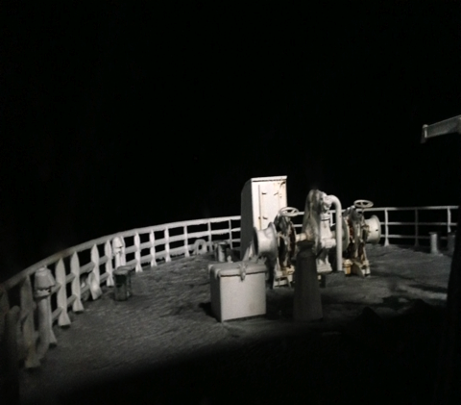
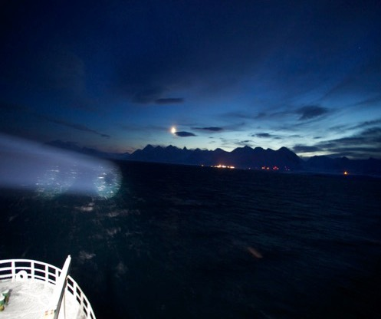
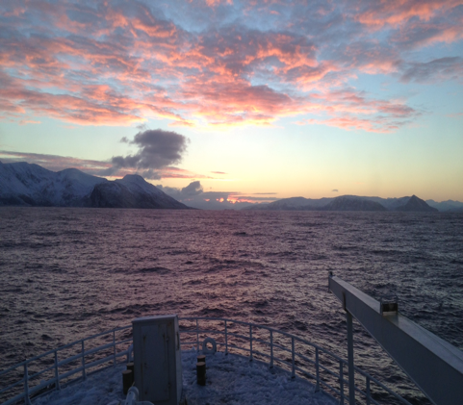
Light in the dead of night
The black box becomes darker at higher latitudes!
Civil polar night at latitudes between 72° and 78°N (sun between 6° and 12° under the horizon). Darkish
Civil twilight at latitudes between polar circel and 72°N (sun between 0° and 6° under the horizon). Dark?
Nautical polar night at latitudes >78°N. Defined by the sun below 12° under the horizon. DARK!
81°
79°
70°
All pictures taken at noon onboard RV Helmer Hanssen mid January 2013

Slide 4
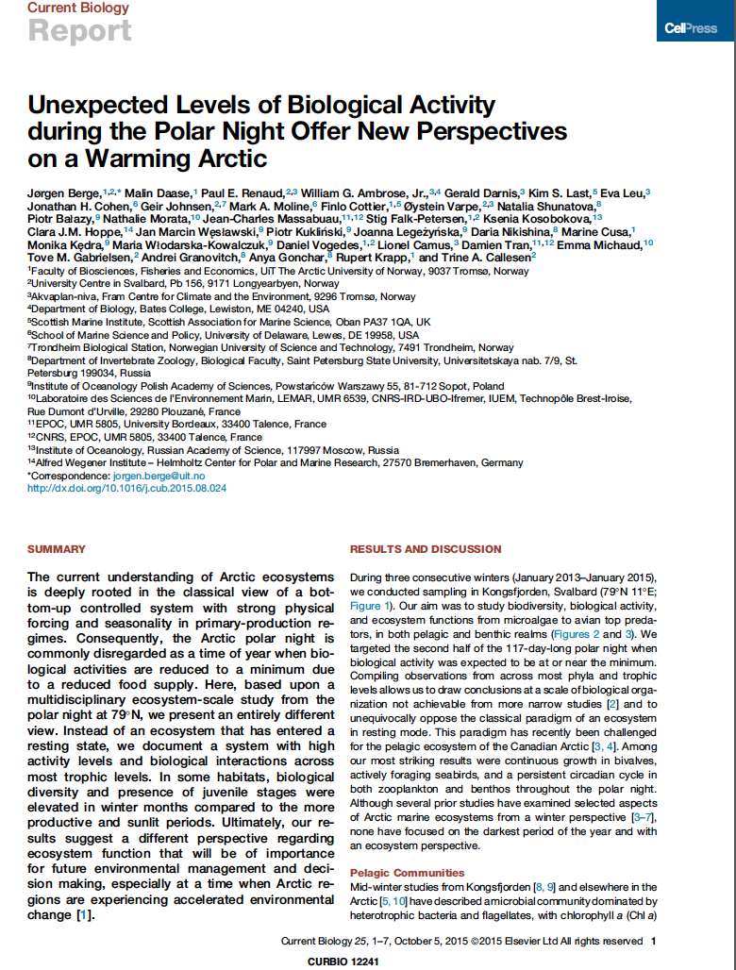
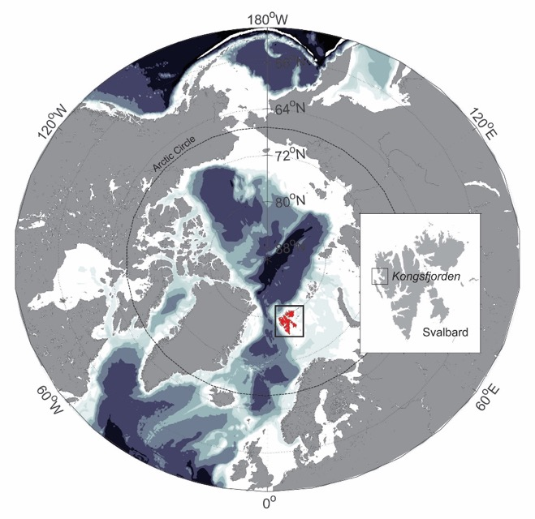
Life in the dead of night
Results from two large field campaigns in Kongsfjorden January 2014 and 2015 in connection to the Mare Incognitum programme

Slide 5
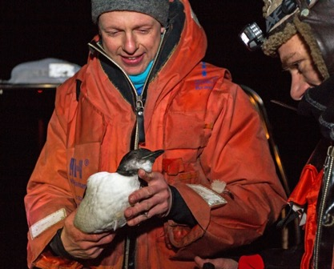
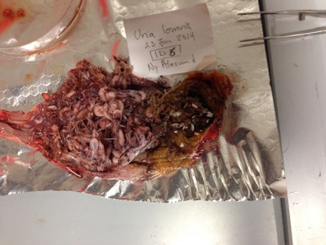
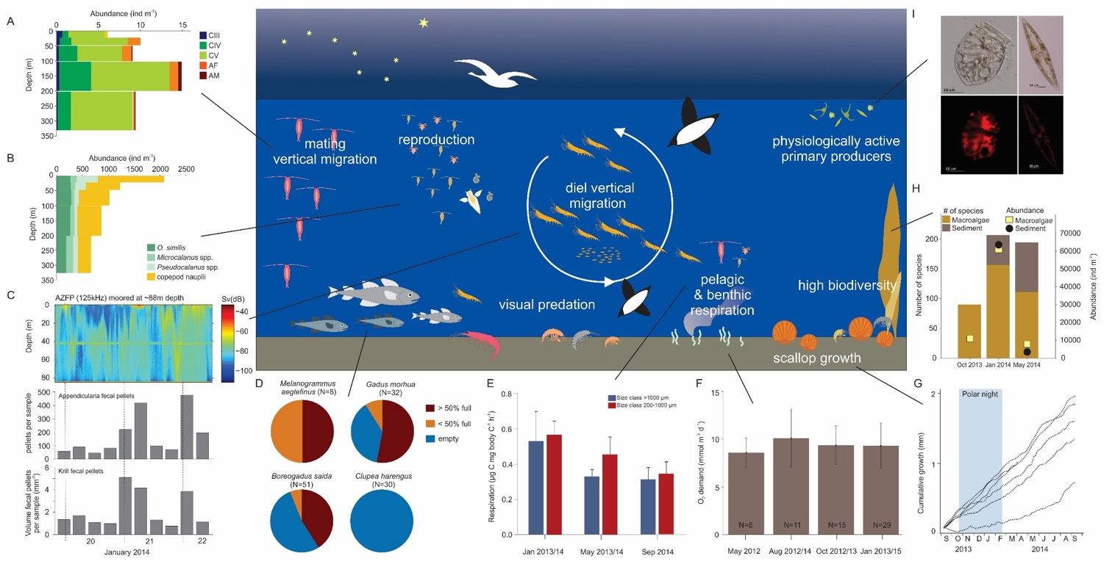
Ecosystem processes during the polar night

Slide 6

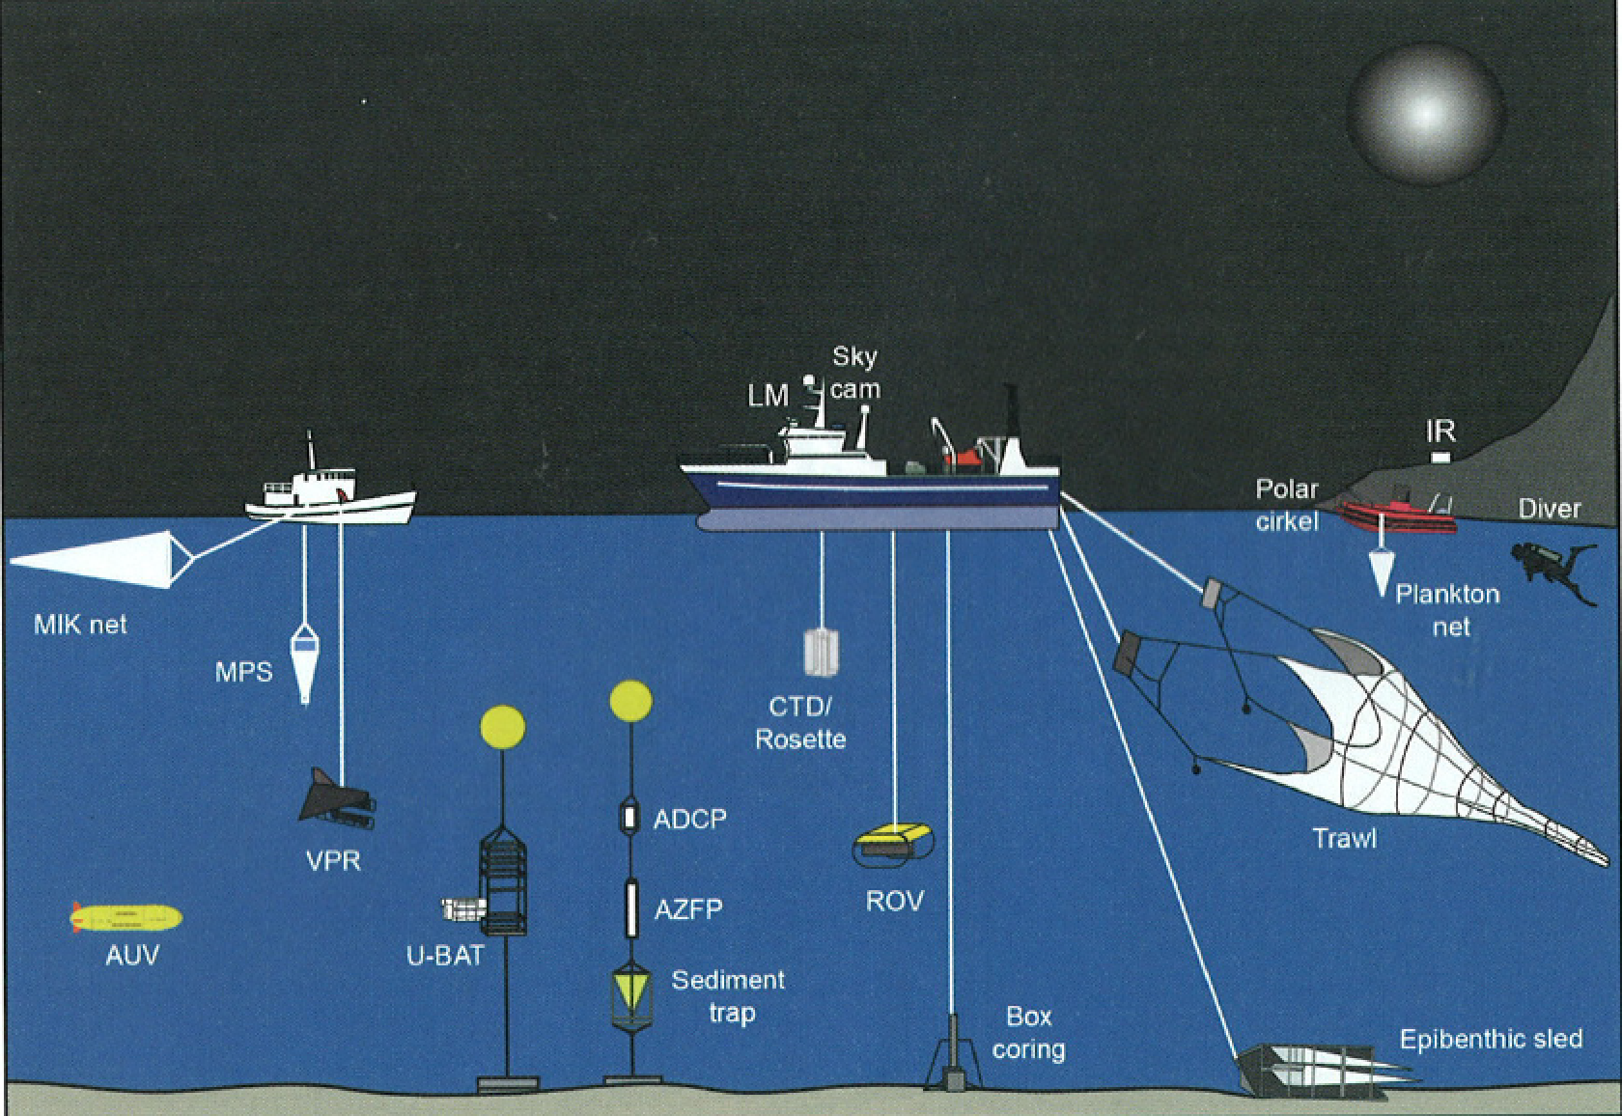
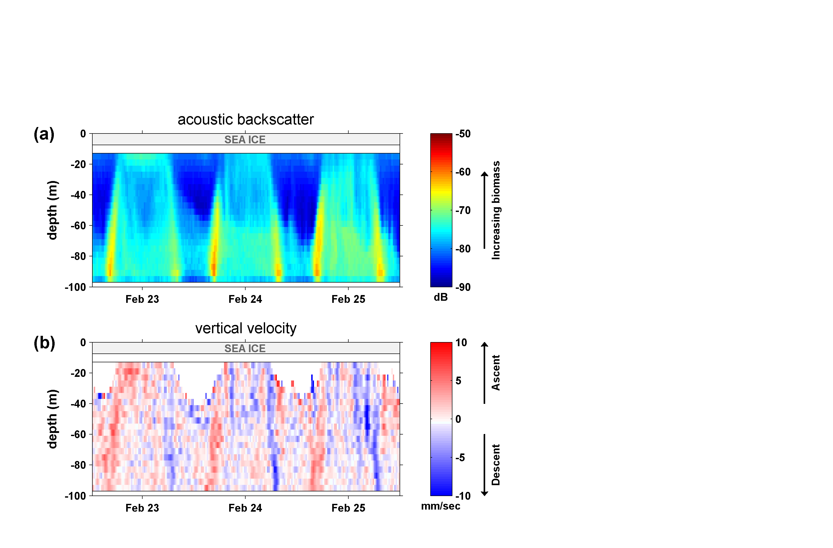
“CircA”
Circadian rhythms of Arctic zooplankton from polar twilight to polar night – patterns, processes, and ecosystem implications
Who?

Slide 7
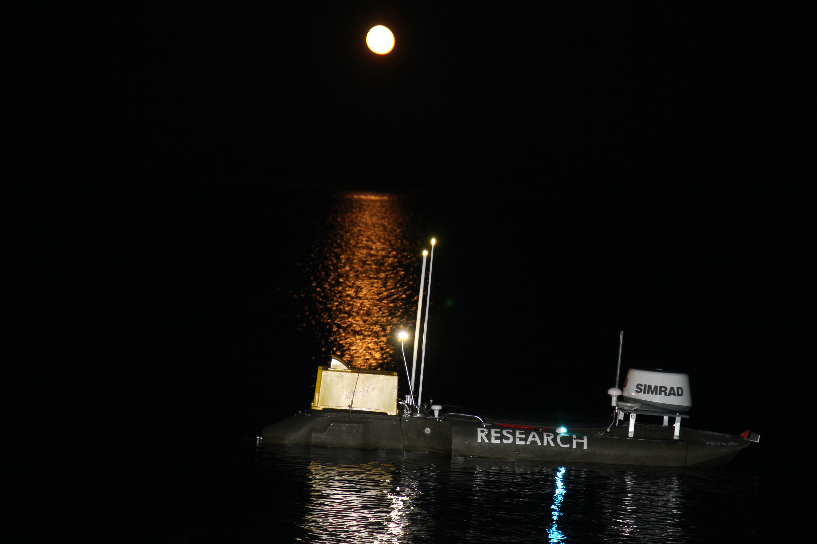

Slide 8
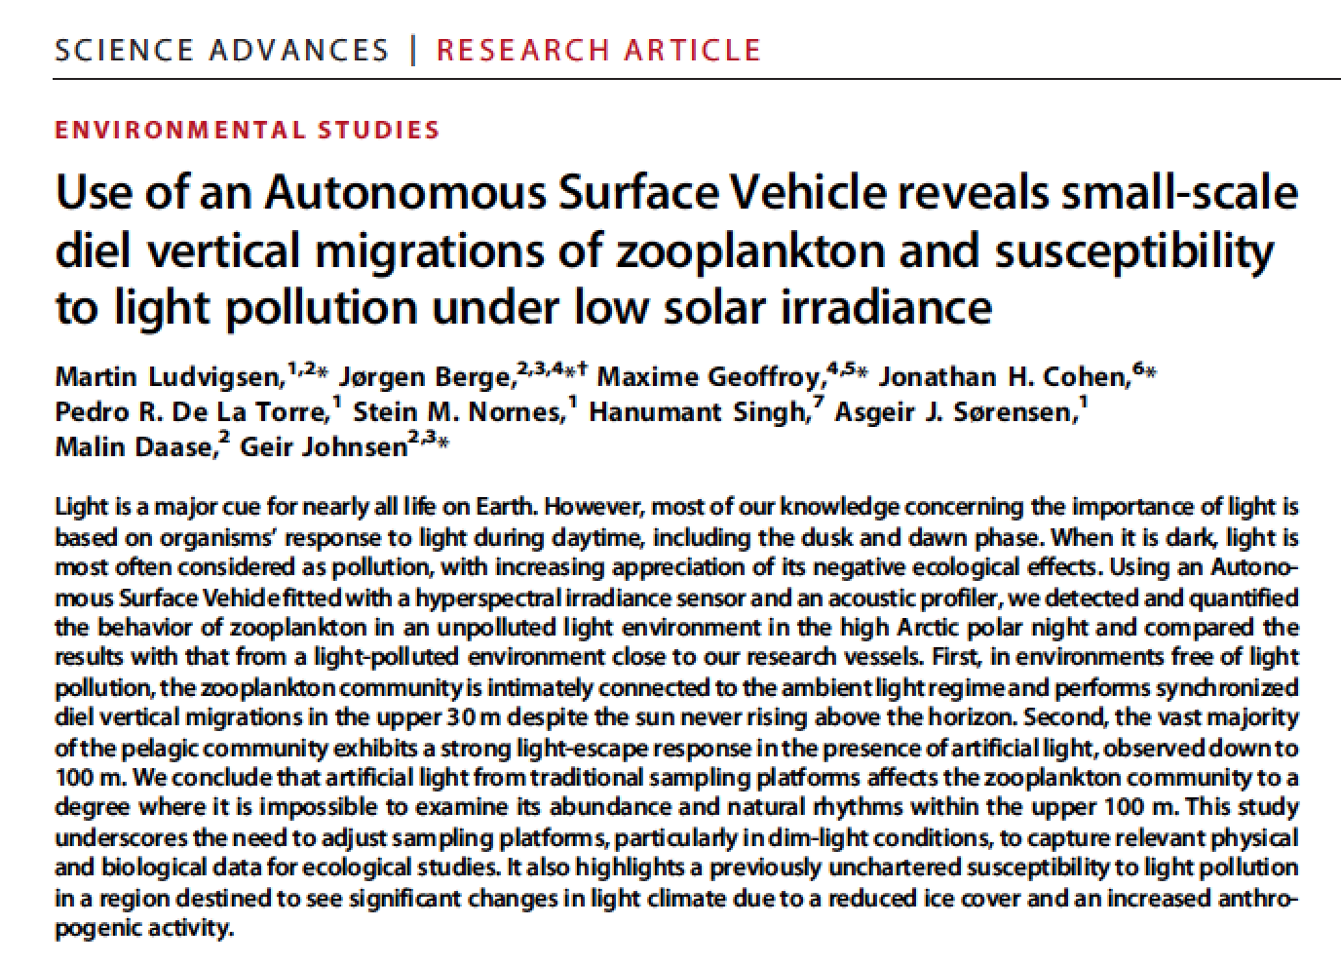
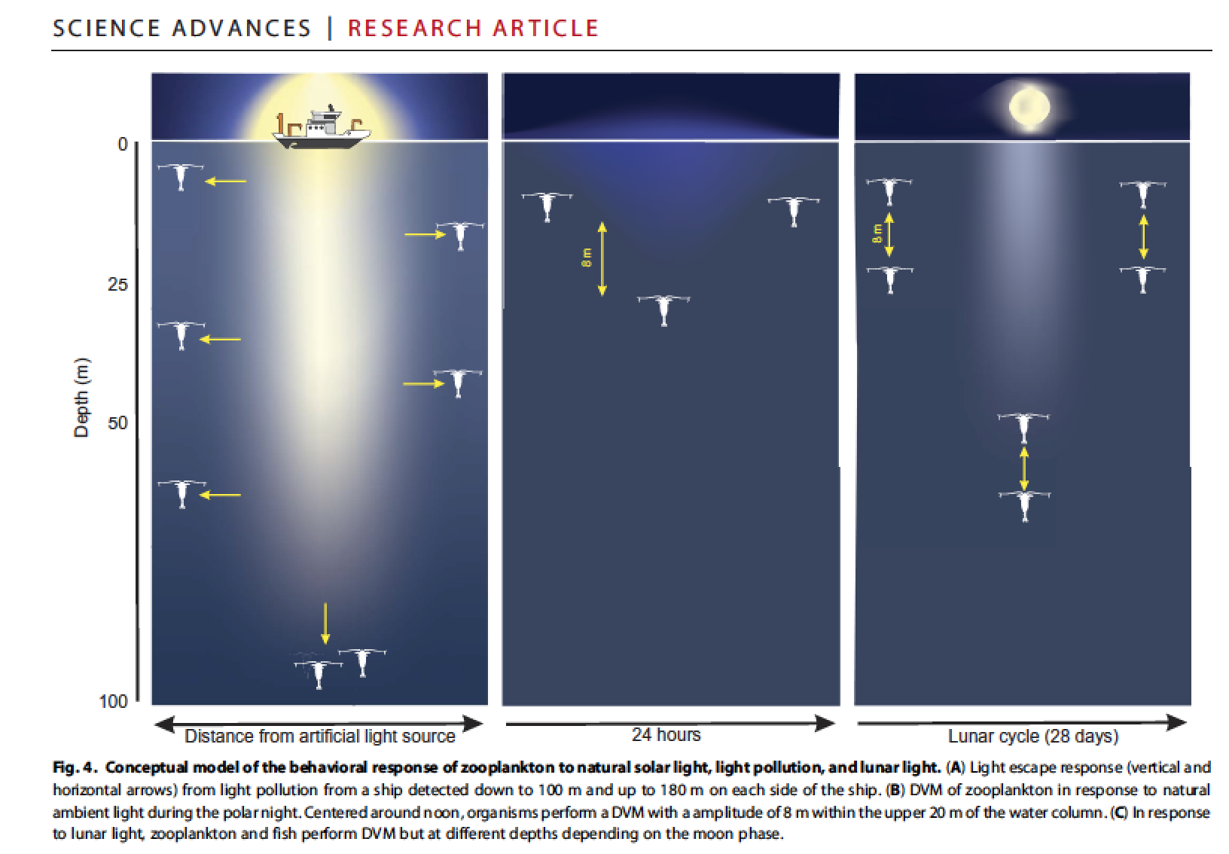

Slide 9
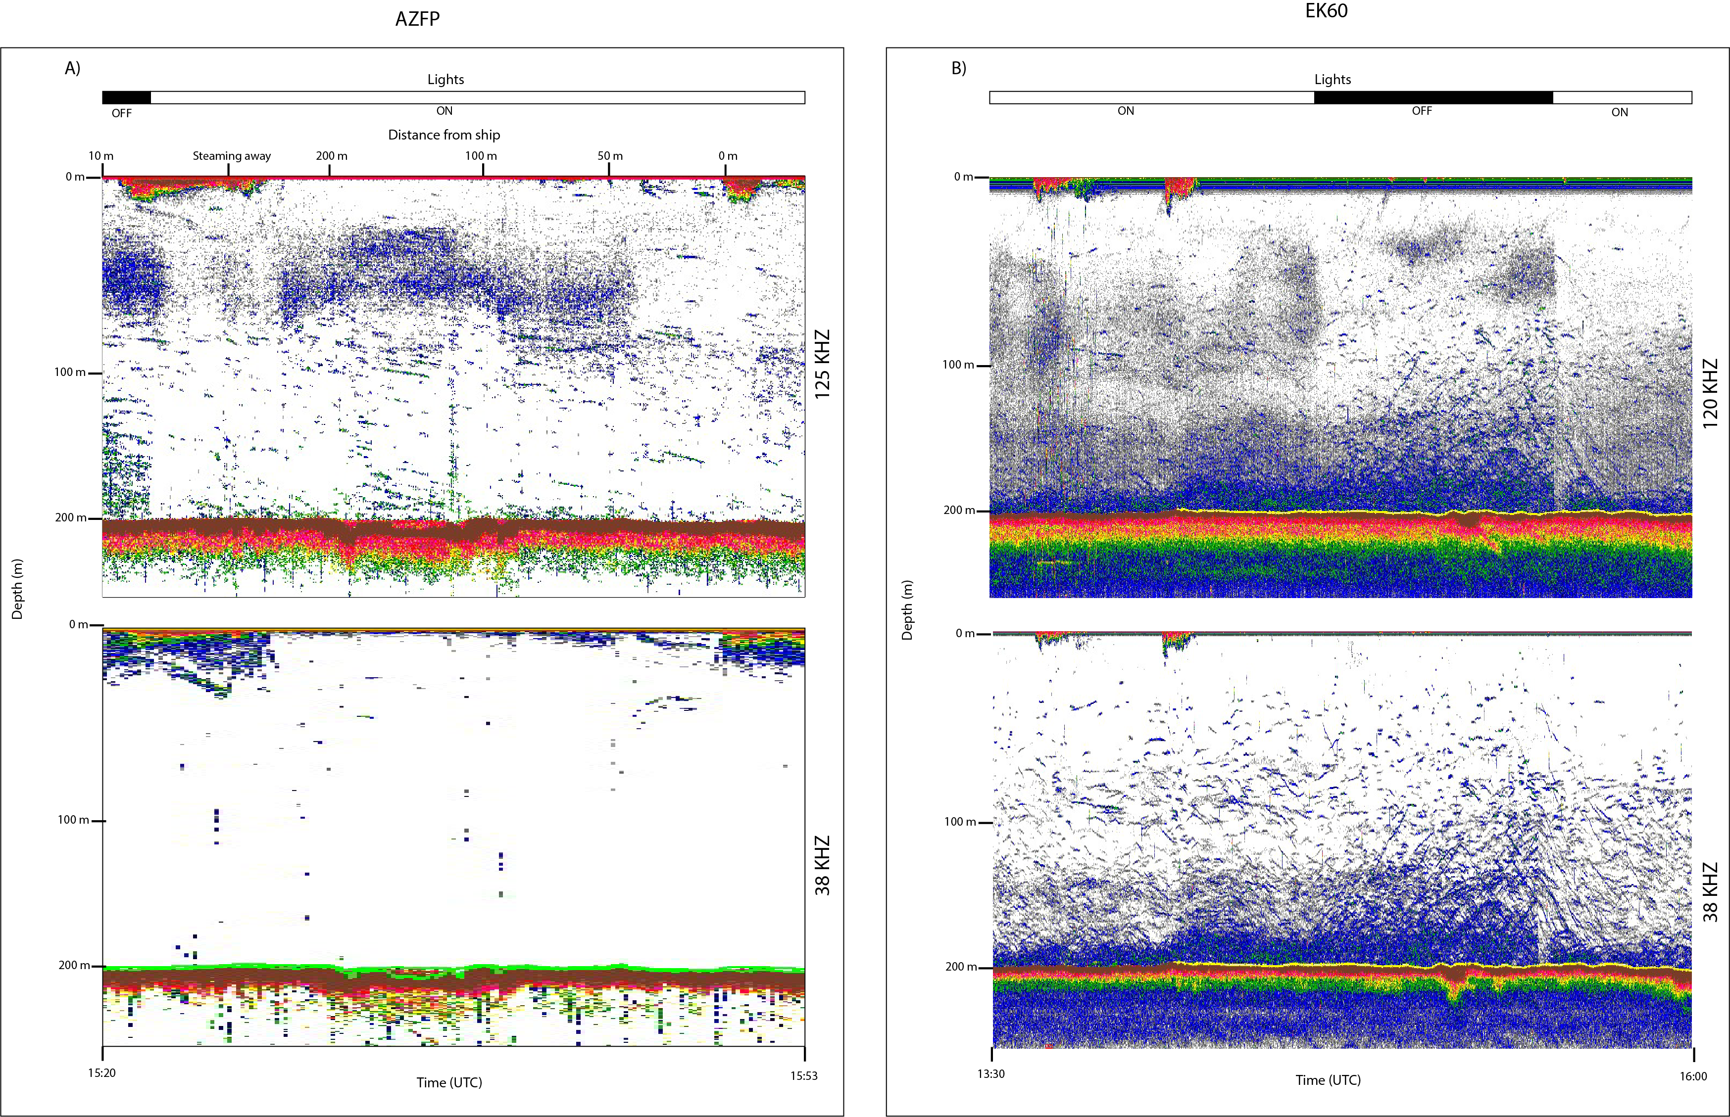
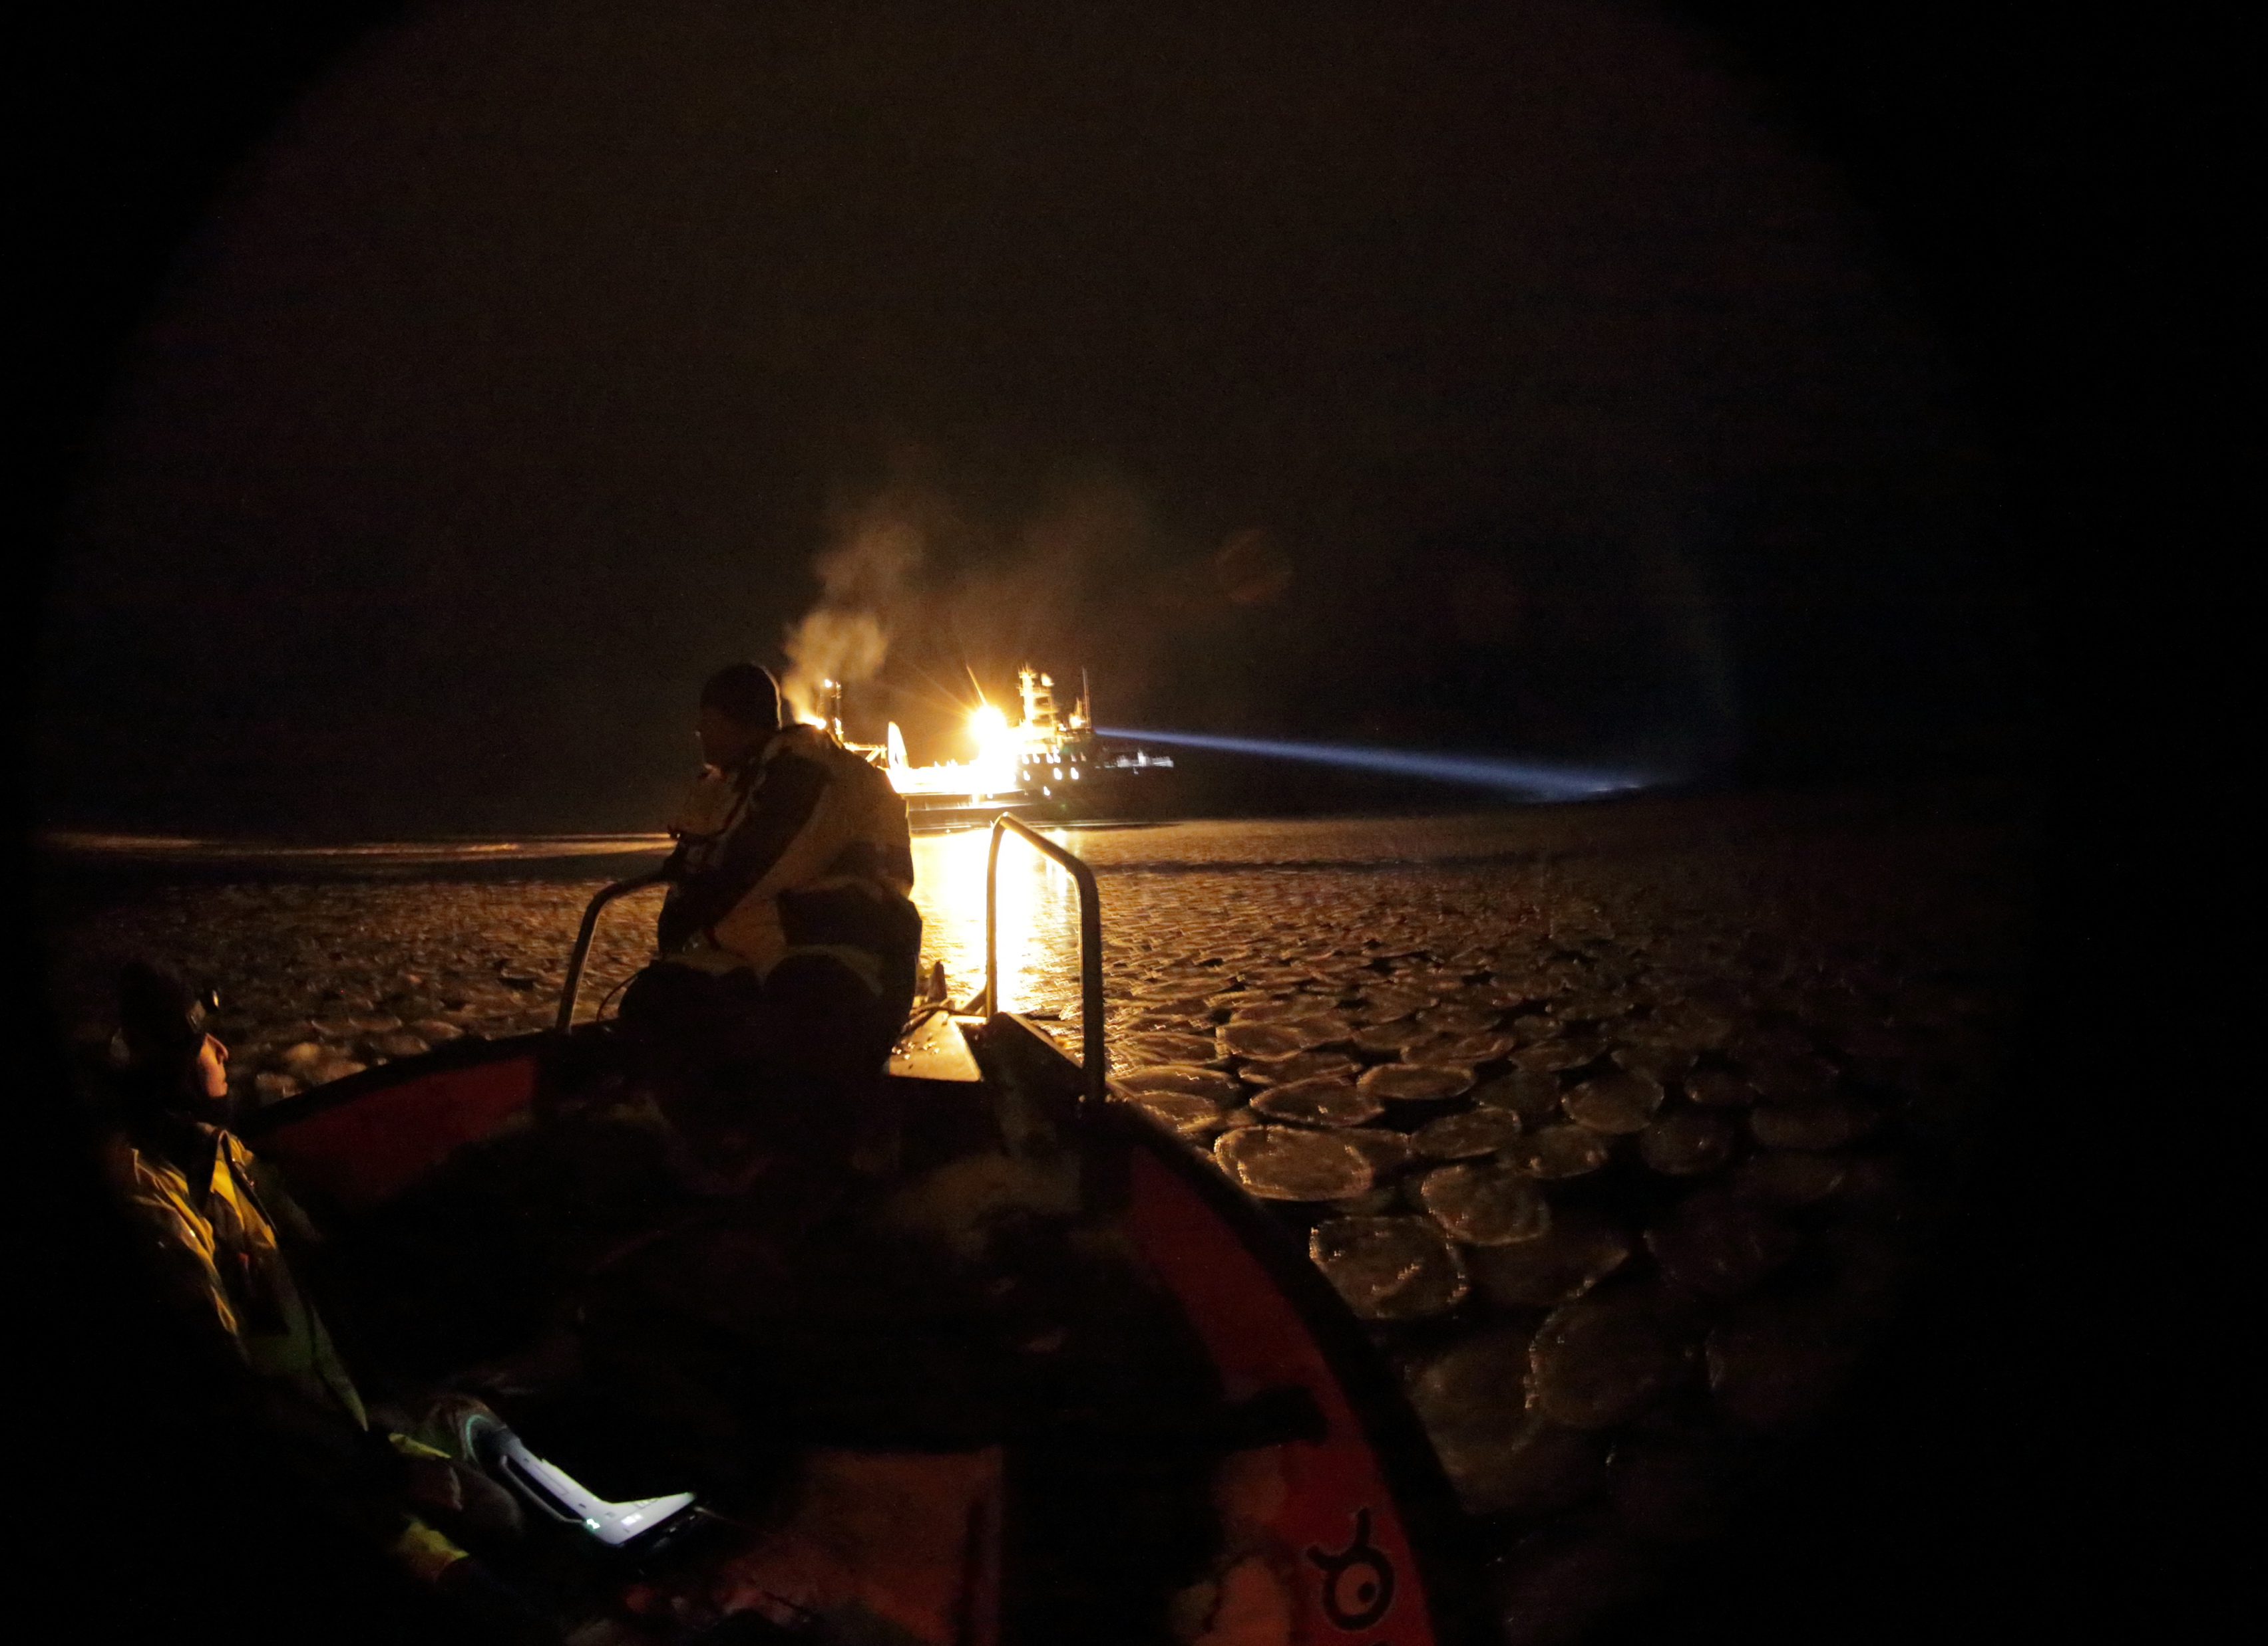

Slide 10
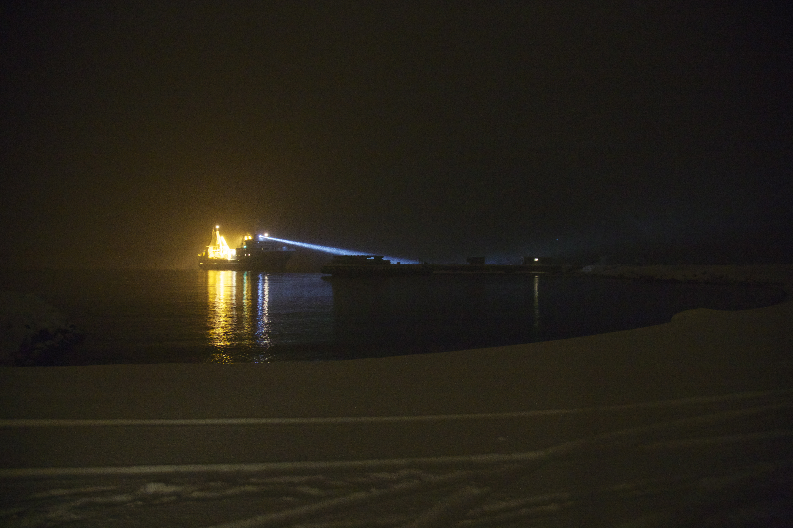
Implications:
How relevant are samples taken from a research vessel in “darkness”?
Acoustics frequently used in stock assessments…reliable?
Different responses in different conditions!
Relevant also for other dim environments

